Slide 1

EE909 – Estimation for Wireless
eMasters – Q2-2023-24
IIT Kanpur
Venkateswar Reddy Melachervu
CTO
24th Sept 2023
Brillium Technologies
#501, C Block, Salarpuria Serenity, 5th Main, Sector 7, HSR Layout, Bengaluru 560102, Karnataka, India
Website: www.brillium.in | Email: connect@brillium.in

Slide 2
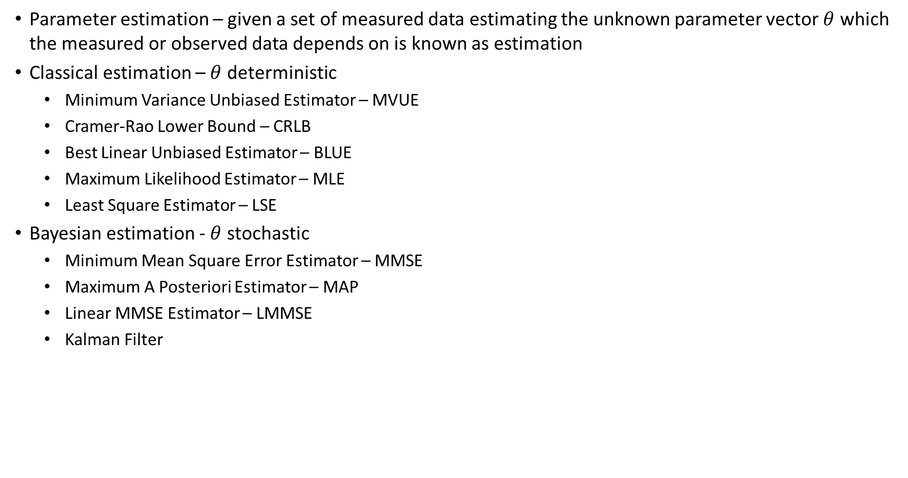
Estimation
Parameter estimation – given a set of measured data estimating the unknown parameter vector $θ$ which the measured or observed data depends on is known as estimation
Classical estimation – $θ$ deterministic
  Minimum Variance Unbiased Estimator – MVUE
  Cramer-Rao Lower Bound – CRLB
  Best Linear Unbiased Estimator – BLUE
  Maximum Likelihood Estimator – MLE
  Least Square Estimator – LSE
Bayesian estimation - $θ$ stochastic
  Minimum Mean Square Error Estimator – MMSE
  Maximum A Posteriori Estimator – MAP
  Linear MMSE Estimator – LMMSE
  Kalman Filter

Slide 3
What does Joint PDF Mean?
The joint probability density function (joint PDF) intuitively represents the likelihood of two or more continuous random variables simultaneously taking on specific values. In other words, it provides a way to model the probability distribution of a multivariate random variable.
For two random variables, let's say X and Y, the joint PDF f(x, y) gives the probability density of X taking on a value in a certain range and Y taking on a value in another range. The joint PDF is defined over the entire range of possible values for X and Y.
Intuitively, you can think of the joint PDF as describing how "dense" the probability is around different points in the multidimensional space defined by the variables X and Y. Higher values of the joint PDF indicate regions in this space where the likelihood of the variables having specific values is higher.
Mathematically, the joint PDF must satisfy certain properties, such as being non-negative over its entire range and integrating to 1 over the entire space. It is a fundamental concept in probability theory and is used in various applications, including statistics, machine learning, and signal processing, to model and analyze the relationships between multiple random variables.
To gain more insight, you can also derive marginal probability density functions from the joint PDF. The marginal PDFs represent the probability distribution of each variable individually, ignoring the other variable. Integrating the joint PDF over one variable gives you the marginal PDF for the other variable.

Slide 4
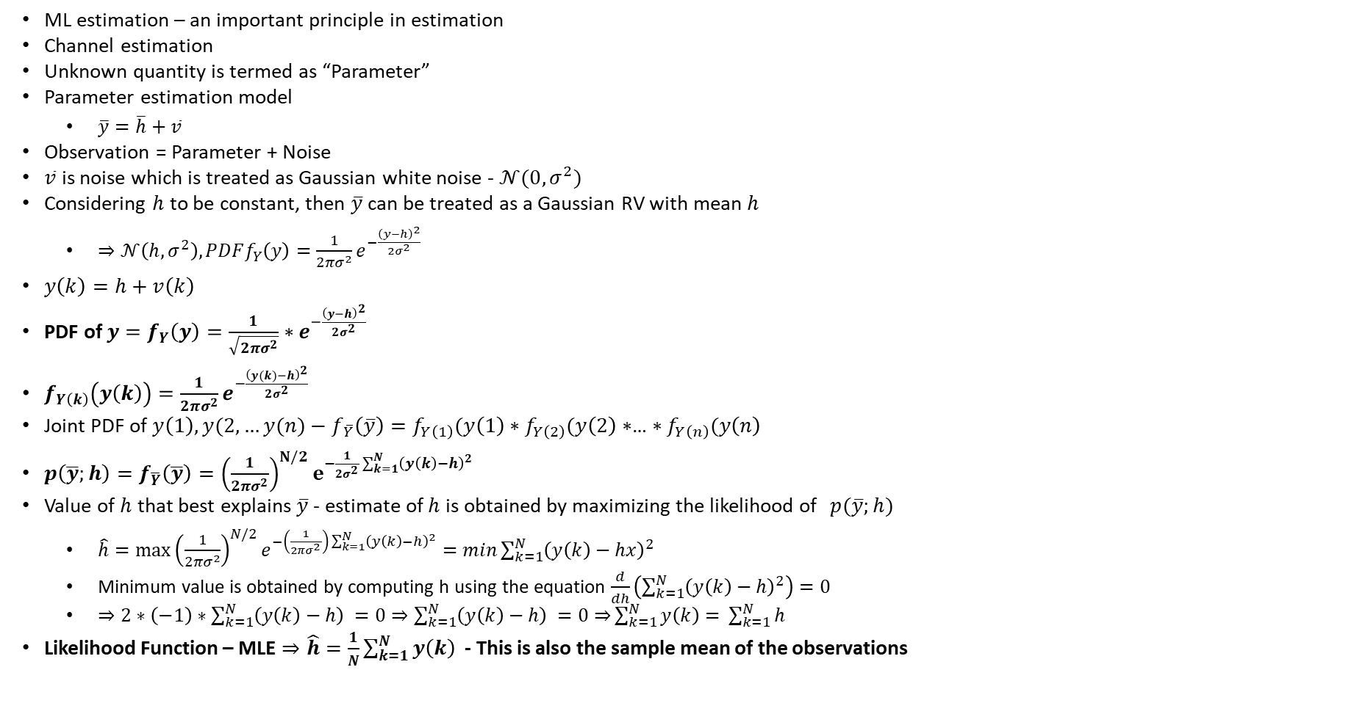
ML – Maximum Likelihood Estimation
ML estimation – an important principle in estimation
Channel estimation
Unknown quantity is termed as “Parameter”
Parameter estimation model
  $\overline{y}=\overline{h}+\overline{v}$
Observation = Parameter + Noise
$\overline{v}$ is noise which is treated as Gaussian white noise - $𝒩(0,σ^{2})$
Considering $h$ to be constant, then $\overline{y}$ can be treated as a Gaussian RV with mean $h$
  $⇒𝒩\left(h,σ^{2}\right), PDFf_{Y}\left(y\right)=\frac{1}{2πσ^{2}}e^{−\frac{{\left(y−h\right)}^{2}}{2σ^{2}}}$
$y\left(k\right)=h+v\left(k\right)$
PDF of $y=f_{Y}\left(y\right)=\frac{1}{\sqrt{2πσ^{2}}}∗e^{−\frac{{\left(y−h\right)}^{2}}{2σ^{2}} }$
$f_{Y\left(k\right)}\left(y\left(k\right)\right)=\frac{1}{2πσ^{2}}e^{−\frac{{\left(y(k)−h\right)}^{2}}{2σ^{2}}}$
Joint PDF of $y\left(1\right), y(2,…y(n)$ $− f_{\overline{Y}}\left(\overline{y}\right)=f_{Y\left(1\right)}(y\left(1\right)∗f_{Y\left(2\right)}(y\left(2\right)∗$… $∗f_{Y\left(n\right)}(y\left(n\right)$
$p\left(\overline{y};h\right)=f_{\overline{Y}}\left(\overline{y}\right)={\left(\frac{1}{2πσ^{2}}\right)}^{N/2}e^{−\frac{1}{2σ^{2}}\sum_{k=1}^{N}{{\left(y\left(k\right)−h\right)}^{2}}}$
Value of $h$ that best explains $\overline{y}$ - estimate of $h$ is obtained by maximizing the likelihood of ${p(\overline{y};h)}$
  $\hat{h}=\max{{\left(\frac{1}{2πσ^{2}}\right)}^{N/2}e^{−\left(\frac{1}{2πσ^{2}}\right)\sum_{k=1}^{N}{{\left(y\left(k\right)−h\right)}^{2}}}}=min\sum_{k=1}^{N}{{\left(y\left(k\right)−hx\right)}^{2}}$
  Minimum value is obtained by computing h using the equation $\frac{d}{dh}\left(\sum_{k=1}^{N}{{\left(y\left(k\right)−h\right)}^{2}}\right)=0$
  $⇒2∗\left(−1\right)∗\sum_{k=1}^{N}{{\left(y\left(k\right)−h\right)}^{ }=0⇒\sum_{k=1}^{N}{{\left(y\left(k\right)−h\right)}^{ }=0⇒}}\sum_{k=1}^{N}{{y\left(k\right)=}^{ }}$ $\sum_{k=1}^{N}{h^{ }}$
Likelihood Function – MLE $⇒\hat{h}=\frac{1}{N}\sum_{k=1}^{N}{{y\left(k\right)}^{ }}$ - This is also the sample mean of the observations

Slide 5
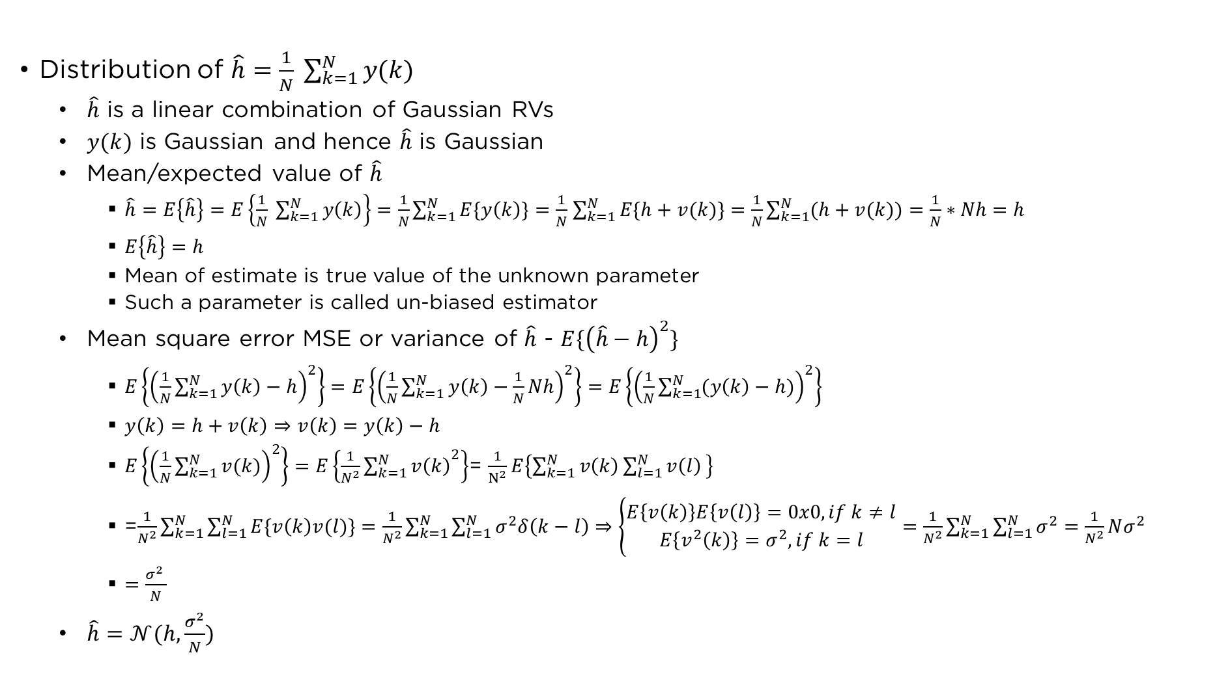
Properties of ML Estimator
Distribution of $\hat{h}=\frac{1}{N} \sum_{k=1}^{N}{y(k)}$
  $\hat{h}$ is a linear combination of Gaussian RVs
  $y(k)$ is Gaussian and hence $\hat{h}$ is Gaussian
  Mean/expected value of $\hat{h}$
    $\hat{h}=E\left\{\hat{h}\right\}=E\left\{\frac{1}{N} \sum_{k=1}^{N}{y\left(k\right)}\right\}=\frac{1}{N}\sum_{k=1}^{N}{E\{y\left(k\right)\}}=\frac{1}{N}$ $\sum_{k=1}^{N}{E\{h+v(k)\}}=\frac{1}{N}\sum_{k=1}^{N}{(h+v(k))}=\frac{1}{N}∗Nh=h$
    $E\left\{\hat{h}\right\}=h$
    Mean of estimate is true value of the unknown parameter
    Such a parameter is called un-biased estimator
  Mean square error MSE or variance of $\hat{h}$ - $E\{{\left(\hat{h}−h\right)}^{2}\}$
    $E\left\{{\left(\frac{1}{N}\sum_{k=1}^{N}{y\left(k\right)}−h\right)}^{2}\right\}=E\left\{{\left(\frac{1}{N}\sum_{k=1}^{N}{y\left(k\right)}−\frac{1}{N}Nh\right)}^{2}\right\}=E\left\{{\left(\frac{1}{N}\sum_{k=1}^{N}{(y\left(k\right)−h)}\right)}^{2}\right\}$
    $y\left(k\right)=h+v\left(k\right)⇒v\left(k\right)=y\left(k\right)−h$
    $E\left\{{\left(\frac{1}{N}\sum_{k=1}^{N}{v(k)}\right)}^{2}\right\}=E\left\{\frac{1}{N^{2}}{\sum_{k=1}^{N}{v\left(k\right)}}^{2}\right\}$= $\frac{1}{N^{2}}E\left\{{\sum_{k=1}^{N}{v\left(k\right)}\sum_{l=1}^{N}{v\left(l\right)}}^{ }\right\}$
    =$\frac{1}{N^{2}}\sum_{k=1}^{N}{\sum_{l=1}^{N}{E\{v\left(k\right)v(l)\}}}=\frac{1}{N^{2}}\sum_{k=1}^{N}{\sum_{l=1}^{N}{σ^{2}δ\left(k−l\right)}}⇒\left\{\begin{aligned}E\left\{v\left(k\right)\right\}E\left\{v\left(l\right)\right\}=0x0, if k≠l \\ E\left\{v^{2}\left(k\right)\right\}=σ^{2}, if k=l\end{aligned}\right.=\frac{1}{N^{2}}\sum_{k=1}^{N}{\sum_{l=1}^{N}{σ^{2}}}=\frac{1}{N^{2}}Nσ^{2}$
    $=\frac{σ^{2} }{N}$
  $\hat{h}=𝒩(h,\frac{σ^{2}}{N})$

Slide 6
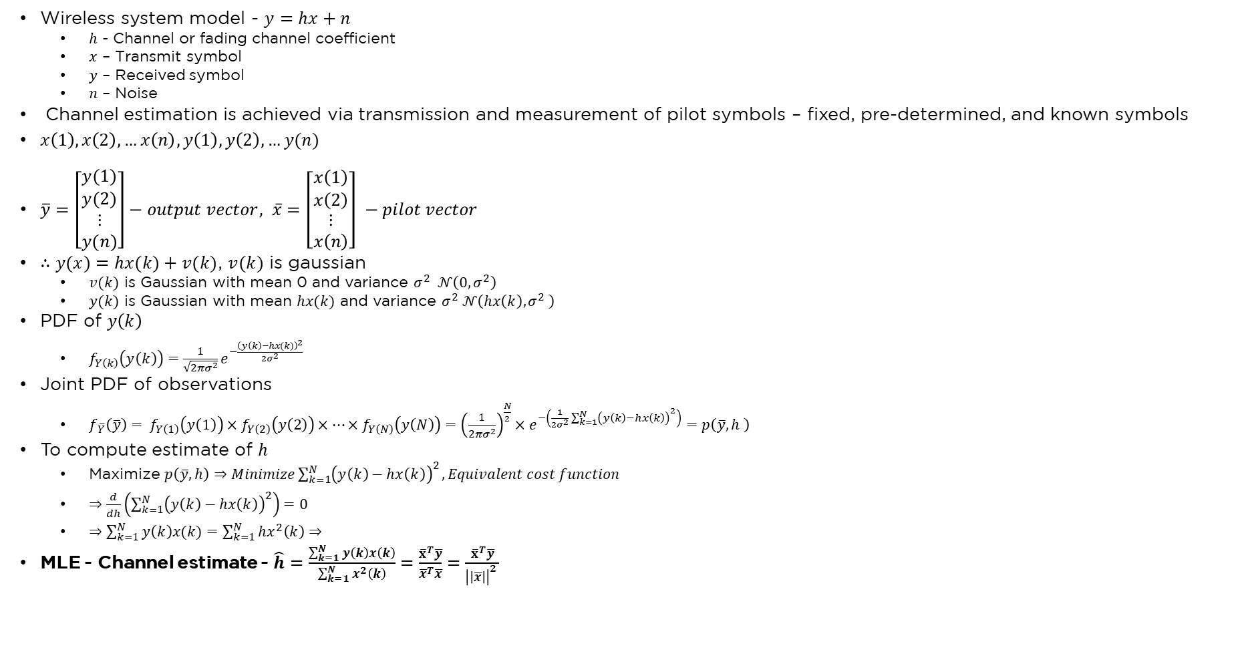
Channel Estimation
Wireless system model - $y=hx+n$
  $h$ - Channel or fading channel coefficient
  $x$ – Transmit symbol
  $y$ – Received symbol
  $n$ – Noise
Channel estimation is achieved via transmission and measurement of pilot symbols – fixed, pre-determined, and known symbols
$x\left(1\right), x\left(2\right),…x\left(n\right), y\left(1\right), y\left(2\right),…y(n)$
$\overline{y}=\left[\begin{matrix}y(1) \\ y(2) \\ \begin{aligned}⋮ \\ y(n)\end{aligned}\end{matrix}\right]−output vector, \overline{x}=\left[\begin{matrix}x\left(1\right) \\ x\left(2\right) \\ \begin{aligned}⋮ \\ x\left(n\right)\end{aligned}\end{matrix}\right] −pilot vector$
$∴y(x)=hx(k)+v(k)$, $v(k)$ is gaussian
  $v(k)$ is Gaussian with mean 0 and variance $σ^{2} 𝒩\left(0,σ^{2}\right)$
  $y(k)$ is Gaussian with mean $hx(k)$ and variance $σ^{2} 𝒩\left(hx\left(k\right), σ^{2} \right)$
PDF of $y\left(k\right)$
  $f_{Y\left(k\right)}\left(y\left(k\right)\right)=\frac{1}{\sqrt{2πσ^{2}}}e^{−\frac{{\left(y\left(k\right)−hx(k)\right)}^{2}}{2σ^{2}}}$
Joint PDF of observations
  $f_{\overline{Y}}\left(\overline{y}\right)= f_{Y\left(1\right)}\left(y\left(1\right)\right)×f_{Y\left(2\right)}\left(y\left(2\right)\right)×…×f_{Y\left(N\right)}\left(y\left(N\right)\right)={\left(\frac{1}{2πσ^{2}}\right)}^{\frac{N}{2}}×e^{−\left(\frac{1}{2σ^{2}}{\sum_{k=1}^{N}{\left(y\left(k\right)−hx\left(k\right)\right)}}^{2}\right)}=p\left(\overline{y},h \right)$
To compute estimate of $h$
  Maximize $p\left(\overline{y},h\right)⇒Minimize{\sum_{k=1}^{N}{\left(y\left(k\right)−hx\left(k\right)\right)}}^{2}, Equivalent cost function$
  $⇒\frac{d}{dh}\left({\sum_{k=1}^{N}{\left(y\left(k\right)−hx\left(k\right)\right)}}^{2}\right)=0$
  $⇒\sum_{k=1}^{N}{y\left(k\right)x(k)}=\sum_{k=1}^{N}{hx^{2}\left(k\right)}⇒$
MLE - Channel estimate - $\hat{h}=\frac{\sum_{k=1}^{N}{y\left(k\right)x\left(k\right)}}{\sum_{k=1}^{N}{x^{2}\left(k\right)}}=\frac{{\overline{x}}^{T}\overline{y}}{{\overline{x}}^{T}\overline{x}}=\frac{{\overline{x}}^{T}\overline{y}}{{\left|\left|\overline{x}\right|\right|}^{2} }$

Slide 7
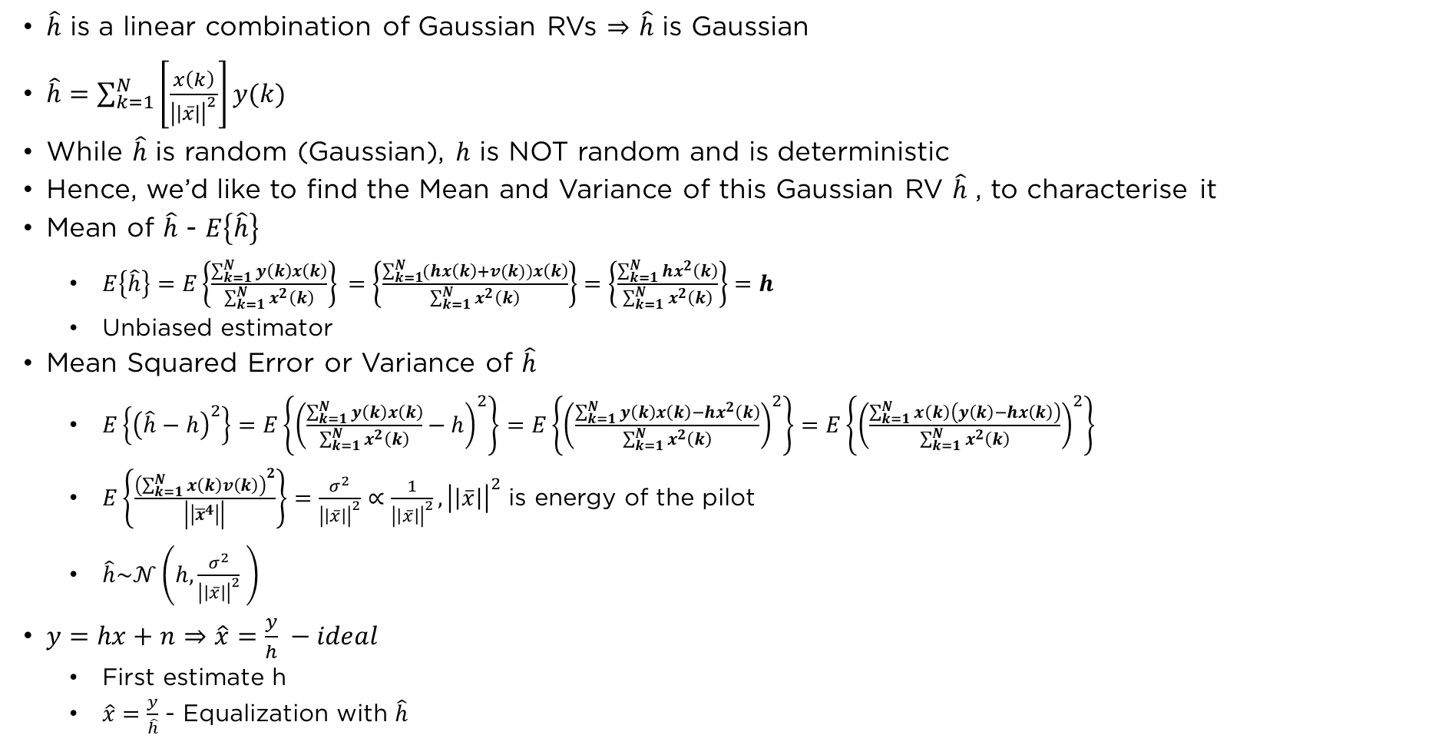
Properties of $\hat{H}$
$\hat{h}$ is a linear combination of Gaussian RVs $⇒$ $\hat{h}$ is Gaussian
$\hat{h}=\sum_{k=1}^{N}{\left[\frac{x\left(k\right)}{{\left|\left|\overline{x}\right|\right|}^{2}}\right]y(k)}$
While $\hat{h}$ is random (Gaussian), $h$ is NOT random and is deterministic
Hence, we’d like to find the Mean and Variance of this Gaussian RV $\hat{h}$ , to characterise it
Mean of $\hat{h}$ - $E\left\{\hat{h}\right\}$
  $E\left\{\hat{h}\right\}=E\left\{\frac{\sum_{k=1}^{N}{y\left(k\right)x\left(k\right)}}{\sum_{k=1}^{N}{x^{2}\left(k\right)}}\right\} =\left\{\frac{\sum_{k=1}^{N}{(hx\left(k\right)+v(k))x\left(k\right)}}{\sum_{k=1}^{N}{x^{2}\left(k\right)}}\right\}=\left\{\frac{\sum_{k=1}^{N}{hx^{2}\left(k\right)}}{\sum_{k=1}^{N}{x^{2}\left(k\right)}}\right\}=h$
  Unbiased estimator
Mean Squared Error or Variance of $\hat{h}$
  $E\left\{{\left(\hat{h}−h\right)}^{2}\right\}=E\left\{{\left(\frac{\sum_{k=1}^{N}{y\left(k\right)x\left(k\right)}}{\sum_{k=1}^{N}{x^{2}\left(k\right)}}−h\right)}^{2}\right\}=E\left\{{\left(\frac{\sum_{k=1}^{N}{y\left(k\right)x\left(k\right)−hx^{2}\left(k\right)}}{\sum_{k=1}^{N}{x^{2}\left(k\right)}}\right)}^{2}\right\}=E\left\{{\left(\frac{\sum_{k=1}^{N}{x\left(k\right)\left(y\left(k\right)−hx\left(k\right)\right)}}{\sum_{k=1}^{N}{x^{2}\left(k\right)}}\right)}^{2}\right\}$
  $E\left\{\frac{{\left(\sum_{k=1}^{N}{x\left(k\right)v\left(k\right)}\right)}^{2}}{\left|\left|{\overline{x}}^{4}\right|\right|}\right\}=\frac{σ^{2}}{{\left|\left|\overline{x}\right|\right|}^{2}}∝\frac{1}{{\left|\left|\overline{x}\right|\right|}^{2}}, {\left|\left|\overline{x}\right|\right|}^{2}$ is energy of the pilot
  $\hat{h}\sim 𝒩\left(h,\frac{σ^{2}}{{\left|\left|\overline{x}\right|\right|}^{2}} \right)$
$y=hx+n⇒\hat{x}=\frac{y}{h} −ideal$
  First estimate h
  $\hat{x}=\frac{y}{\hat{h}}$ - Equalization with $\hat{h}$

Slide 8
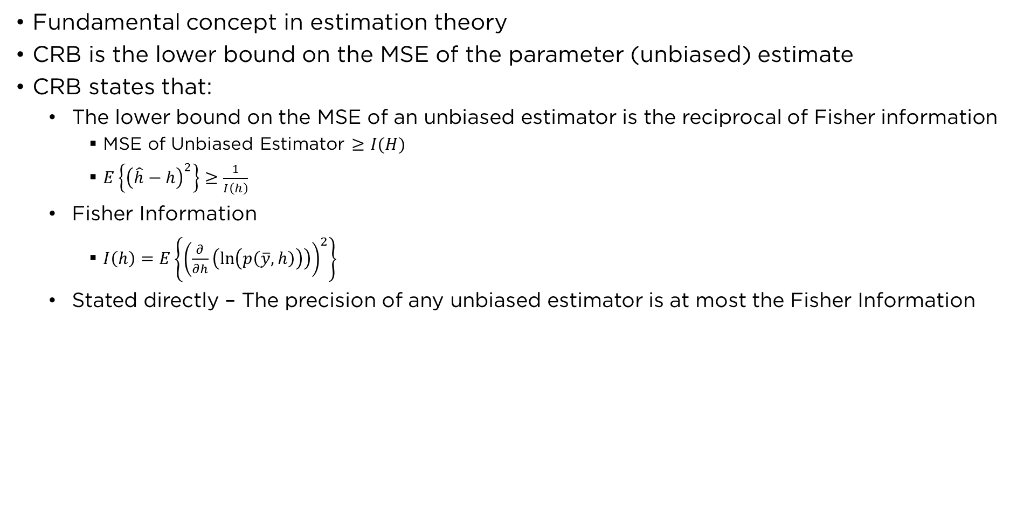
Crámer-Rao Bound - CRB
Fundamental concept in estimation theory
CRB is the lower bound on the MSE of the parameter (unbiased) estimate
CRB states that:
  The lower bound on the MSE of an unbiased estimator is the reciprocal of Fisher information
    MSE of Unbiased Estimator $≥I(H)$
    $E\left\{{\left(\hat{h}−h\right)}^{2}\right\}≥\frac{1}{I\left(h\right)}$
  Fisher Information
    $I\left(h\right)=E\left\{{\left(\frac{∂}{∂h}\left(\ln\left(p\left(\overline{y},h\right)\right)\right)\right)}^{2}\right\}$
  Stated directly – The precision of any unbiased estimator is at most the Fisher Information

Slide 9
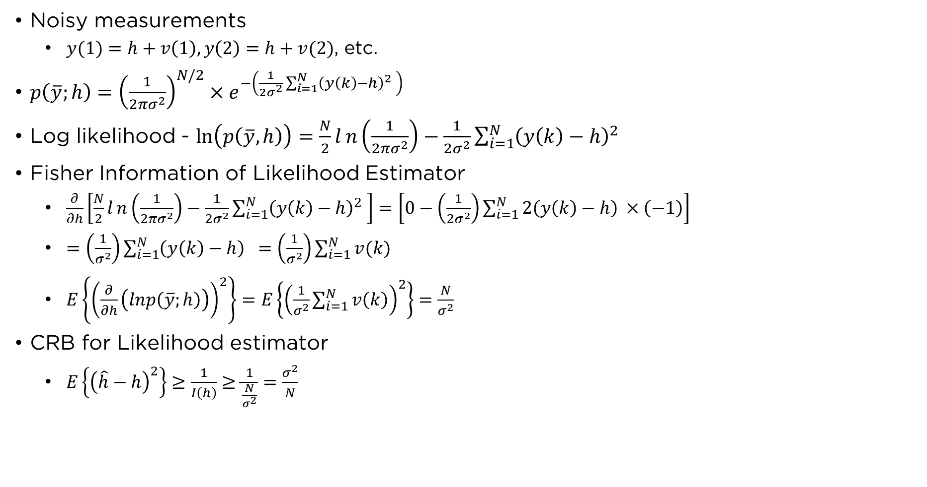
CRB For Noisy Measurement Model
Noisy measurements
  $y(1)=h+v\left(1\right), y\left(2\right)=h+v(2)$, etc.
$p\left(\overline{y};h\right)={\left(\frac{1}{2πσ^{2}}\right)}^{N/2}×e^{−\left(\frac{1}{2σ^{2}}\sum_{i=1}^{N}{{\left(y\left(k\right)−h\right)}^{2} }\right) }$
Log likelihood - $\ln\left(p\left(\overline{y},h\right)\right)=\frac{N}{2}ln\left(\frac{1}{2πσ^{2}}\right)−\frac{1}{2σ^{2}}\sum_{i=1}^{N}{{\left(y\left(k\right)−h\right)}^{2} }$
Fisher Information of Likelihood Estimator
  $\frac{∂}{∂h}\left[\frac{N}{2}ln\left(\frac{1}{2πσ^{2}}\right)−\frac{1}{2σ^{2}}\sum_{i=1}^{N}{{\left(y\left(k\right)−h\right)}^{2} }\right]=\left[0−\left(\frac{1}{2σ^{2}}\right)\sum_{i=1}^{N}{{2\left(y\left(k\right)−h\right)}^{ }×\left(−1\right)}\right]$
  $=\left(\frac{1}{σ^{2}}\right)\sum_{i=1}^{N}{{\left(y\left(k\right)−h\right) }^{ }}=\left(\frac{1}{σ^{2}}\right)\sum_{i=1}^{N}{v(k)}$
  $E\left\{{\left(\frac{∂}{∂h}\left(lnp\left(\overline{y};h\right)\right)\right)}^{2}\right\}=E\left\{{\left(\frac{1}{σ^{2}}\sum_{i=1}^{N}{v\left(k\right)}\right)}^{2}\right\}=\frac{N}{σ^{2}}$
CRB for Likelihood estimator
  $E\left\{{\left(\hat{h}−h\right)}^{2}\right\}≥\frac{1}{I\left(h\right)}≥\frac{1}{\frac{N}{σ^{2}}}=\frac{σ^{2}}{N}$

Slide 10
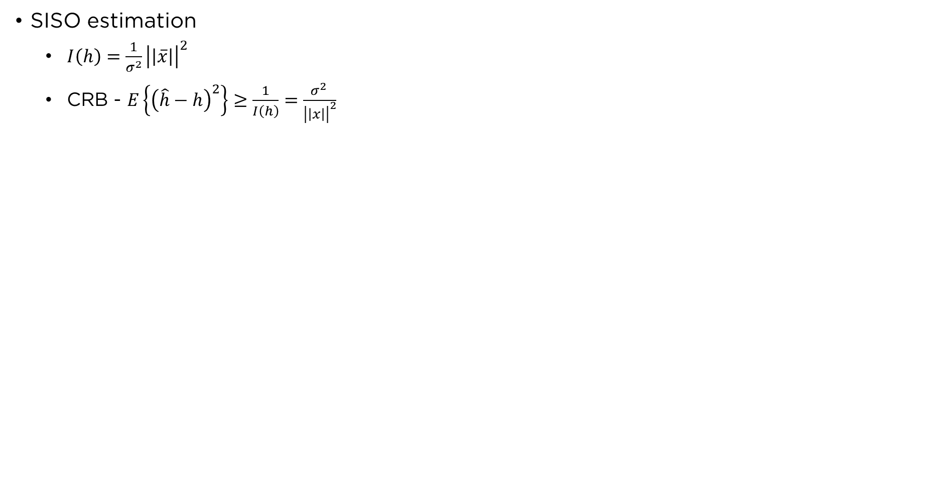
Channel Estimation
SISO estimation
  $I\left(h\right)=\frac{1}{σ^{2}}{\left|\left|\overline{x}\right|\right|}^{2}$
  CRB - $E\left\{{\left(\hat{h}−h\right)}^{2}\right\}≥\frac{1}{I\left(h\right)}=\frac{σ^{2} }{{\left|\left|x\right|\right|}^{2}}$

Slide 11
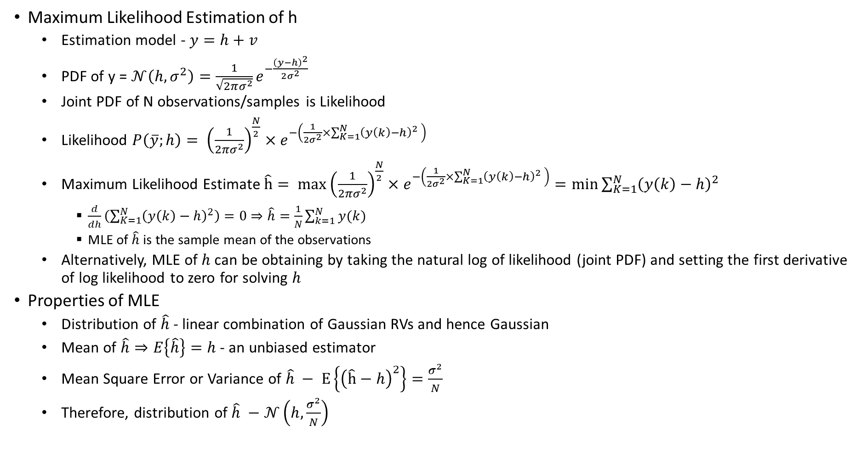
Brief Notes for Quiz-1 – 14th Oct 2023
Maximum Likelihood Estimation of h
  Estimation model - $y=h+v$
  PDF of y = $𝒩\left(h,σ^{2}\right)=\frac{1}{\sqrt{2πσ^{2}}}e^{−\frac{{\left(y−h\right)}^{2}}{2σ^{2}}}$
  Joint PDF of N observations/samples is Likelihood
  Likelihood $P\left(\overline{y};h\right)= {\left(\frac{1}{2πσ^{2}}\right)}^{\frac{N}{2}}×e^{−\left(\frac{1}{2σ^{2}}×\sum_{K=1}^{N}{{\left(y\left(k\right)−h\right)}^{2}} \right)}$
  Maximum Likelihood Estimate $\hat{h}= \max_{ }{{\left(\frac{1}{2πσ^{2}}\right)}^{\frac{N}{2}}×e^{−\left(\frac{1}{2σ^{2}}×\sum_{K=1}^{N}{{\left(y\left(k\right)−h\right)}^{2}} \right)}}=\min_{ }{\sum_{K=1}^{N}{{\left(y\left(k\right)−h\right)}^{2}}}$
    $\frac{d}{dh}\left(\sum_{K=1}^{N}{{\left(y\left(k\right)−h\right)}^{2}}\right)=0⇒\hat{h}=\frac{1}{N}\sum_{k=1}^{N}{y(k)}$
    MLE of $\hat{h}$ is the sample mean of the observations
  Alternatively, MLE of $h$can be obtaining by taking the natural log of likelihood (joint PDF) and setting the first derivative of log likelihood to zero for solving $h$
Properties of MLE
  Distribution of $\hat{h}$ - linear combination of Gaussian RVs and hence Gaussian
  Mean of $\hat{h}⇒E\left\{\hat{h}\right\}=h$ - an unbiased estimator
  Mean Square Error or Variance of $\hat{h} − E\left\{{\left(\hat{h}−h\right)}^{2}\right\}=\frac{σ^{2}}{N}$
  Therefore, distribution of $\hat{h} −𝒩\left(h,\frac{σ^{2}}{N}\right)$

Slide 12
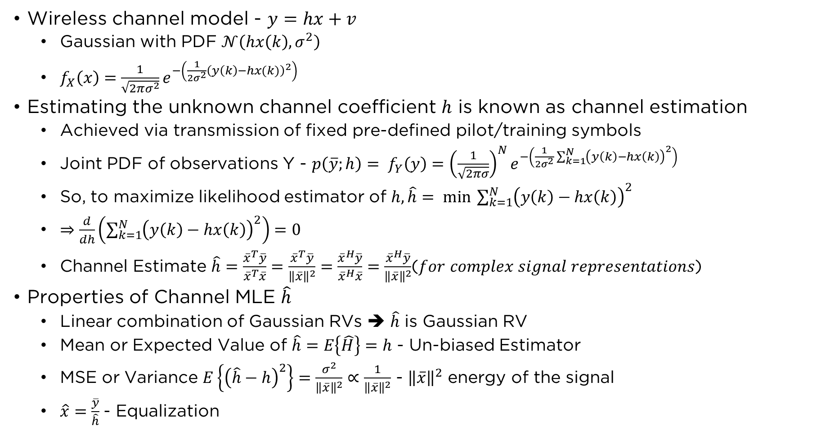
Channel Estimation
Wireless channel model - $y=hx+v$
  Gaussian with PDF $𝒩\left(hx\left(k\right), σ^{2}\right)$
  $f_{X}\left(x\right)=\frac{1}{\sqrt{2πσ^{2}}}e^{−\left(\frac{1}{2σ^{2}}{\left(y\left(k\right)−hx(k)\right)}^{2}\right)}$
Estimating the unknown channel coefficient $h$ is known as channel estimation
  Achieved via transmission of fixed pre-defined pilot/training symbols
  Joint PDF of observations Y - $p\left(\overline{y};h\right)= f_{Y}\left(y\right)={\left(\frac{1}{\sqrt{2πσ}}\right)}^{N}e^{−\left(\frac{1}{2σ^{2}}\sum_{k=1}^{N}{{\left(y\left(k\right)−hx\left(k\right)\right)}^{2}}\right) }$
  So, to maximize likelihood estimator of $h, \hat{h}= \min_{ }{\sum_{k=1}^{N}{{\left(y\left(k\right)−hx\left(k\right)\right)}^{2}}}$
  $⇒\frac{d}{dh}\left(\sum_{k=1}^{N}{{\left(y\left(k\right)−hx\left(k\right)\right)}^{2}}\right)=0$
  Channel Estimate $\hat{h}=\frac{{\overline{x}}^{T}\overline{y}}{{\overline{x}}^{T}\overline{x}}=\frac{{\overline{x}}^{T}\overline{y}}{{\left\|\overline{x}\right\|}^{2}}=\frac{{\overline{x}}^{H}\overline{y}}{{\overline{x}}^{H}\overline{x}}=\frac{{\overline{x}}^{H}\overline{y}}{{\left\|\overline{x}\right\|}^{2}}$(𝑓𝑜𝑟 𝑐𝑜𝑚𝑝𝑙𝑒𝑥 𝑠𝑖𝑔𝑛𝑎𝑙 𝑟𝑒𝑝𝑟𝑒𝑠𝑒𝑛𝑡𝑎𝑡𝑖𝑜𝑛𝑠)
Properties of Channel MLE $\hat{h}$
  Linear combination of Gaussian RVs ➔ $\hat{h}$ is Gaussian RV
  Mean or Expected Value of $\hat{h}=E\left\{\hat{H}\right\}=h$ - Un-biased Estimator
  MSE or Variance $E\left\{{\left(\hat{h}−h\right)}^{2}\right\}=\frac{σ^{2}}{{\left\|\overline{x}\right\|}^{2}}∝\frac{1}{{\left\|\overline{x}\right\|}^{2}}$ - ${\left\|\overline{x}\right\|}^{2}$ energy of the signal
  $\hat{x}=\frac{\overline{y}}{\hat{h}}$- Equalization

Slide 13
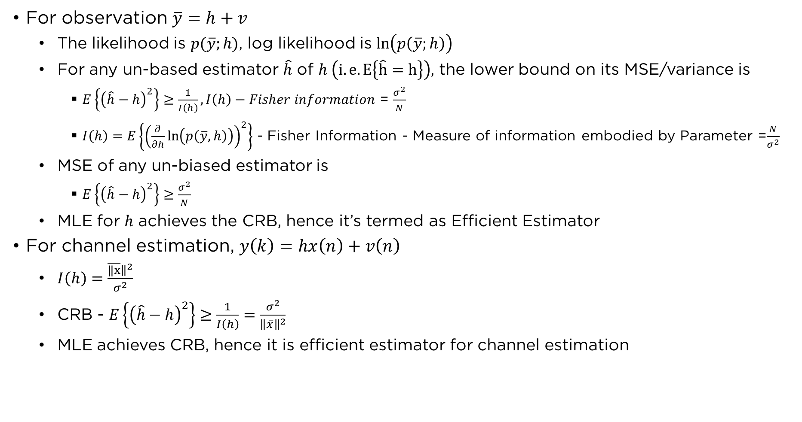
Crámer-Rao Bound
For observation $\overline{y}=h+v$
  The likelihood is $p(\overline{y};h)$, log likelihood is $\ln\left(p\left(\overline{y};h\right)\right)$
  For any un-based estimator $\hat{h}$ of $h \left(i.e. E\left\{\hat{h}=h\right\}\right)$, the lower bound on its MSE/variance is
    $E\left\{{\left(\hat{h}−h\right)}^{2}\right\}≥\frac{1}{I\left(h\right)}, I\left(h\right)−Fisher information$ = $\frac{σ^{2}}{N}$
    $I\left(h\right)=E\left\{{\left(\frac{∂}{∂h}\ln\left(p\left(\overline{y},h\right)\right)\right)}^{2}\right\}$ - Fisher Information - Measure of information embodied by Parameter =$\frac{N}{σ^{2}}$
  MSE of any un-biased estimator is
    $E\left\{{\left(\hat{h}−h\right)}^{2}\right\}≥\frac{σ^{2}}{N}$
  MLE for $h$ achieves the CRB, hence it’s termed as Efficient Estimator
For channel estimation, $y\left(k\right)=hx\left(n\right)+v\left(n\right)$
  $I\left(h\right)=\frac{\overline{‖x}{\left.​\right\|}^{2}}{σ^{2}}$
  CRB - $E\left\{{\left(\hat{h}−h\right)}^{2}\right\}≥\frac{1}{I\left(h\right)}=\frac{σ^{2}}{{\left\|\overline{x}\right\|}^{2}}$
  MLE achieves CRB, hence it is efficient estimator for channel estimation

Slide 14
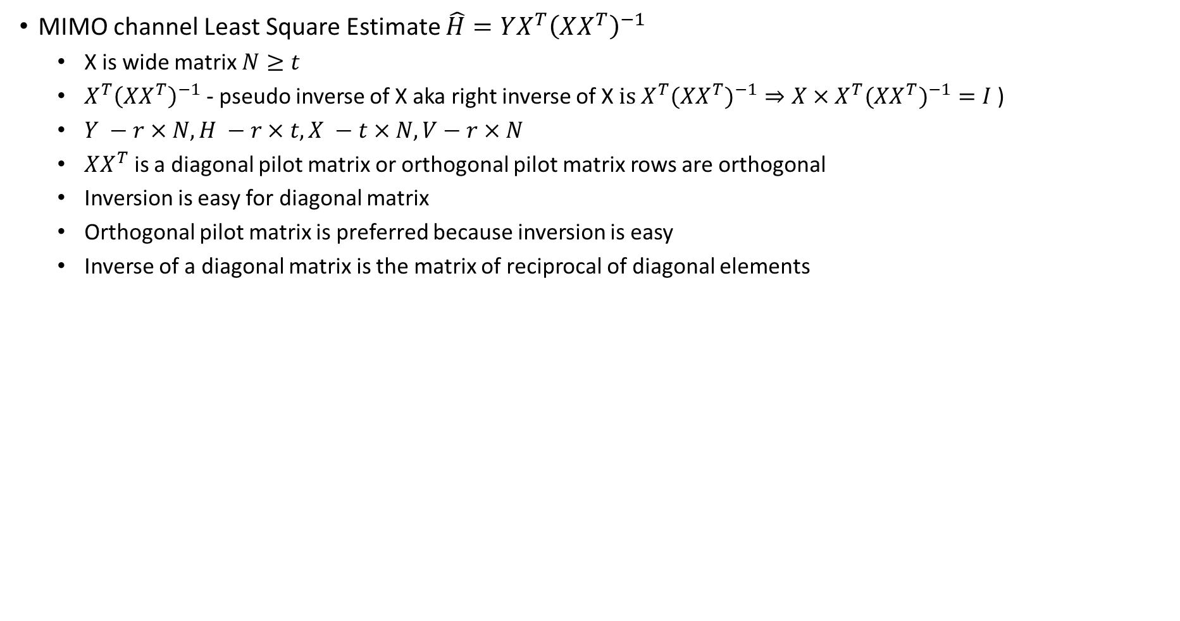
Chapter – 5 – MIMO Channel Estimation
MIMO channel Least Square Estimate $\hat{H}=YX^{T}{\left(XX^{T}\right)}^{−1}$
  X is wide matrix $N≥t$
  $X^{T}{\left(XX^{T}\right)}^{−1}$ - pseudo inverse of X aka right inverse of X $is X^{T}({XX^{T})}^{−1}⇒X×X^{T}({XX^{T})}^{−1}=I$)
  $Y −r×N, H −r×t, X −t×N, V−r×N$
  $XX^{T}$ is a diagonal pilot matrix or orthogonal pilot matrix rows are orthogonal
  Inversion is easy for diagonal matrix
  Orthogonal pilot matrix is preferred because inversion is easy
  Inverse of a diagonal matrix is the matrix of reciprocal of diagonal elements

Slide 15
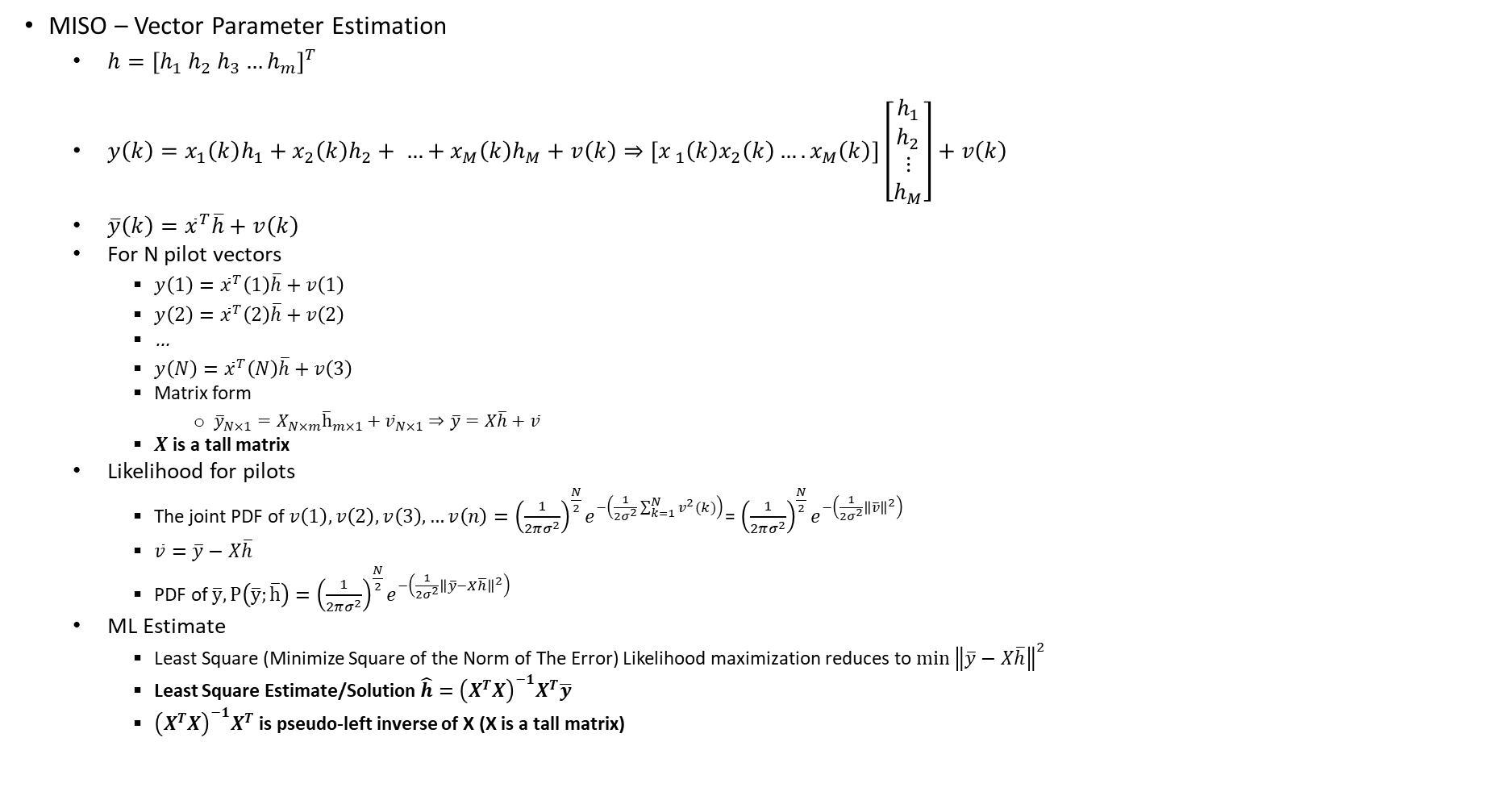
Quiz-2 – 28th Oct 2023
MISO – Vector Parameter Estimation
  $h={\left[h_{1} h_{2} h_{3}…h_{m}\right]}^{T}$
  $y\left(k\right)=x_{1}\left(k\right)h_{1}+x_{2}\left(k\right)h_{2}+ …+x_{M}\left(k\right)h_{M}+v\left(k\right)⇒\left[x_{ 1}\left(k\right)x_{2}\left(k\right)….x_{M}\left(k\right)\right]\left[\begin{matrix}h_{1} \\ h_{2} \\ \begin{aligned}⋮ \\ h_{M}\end{aligned}\end{matrix}\right]+v\left(k\right)$
  $\overline{y}\left(k\right)={\overline{x}}^{T}\overline{h}+v\left(k\right)$
  For N pilot vectors
    $y\left(1\right)={\overline{x}}^{T}\left(1\right)\overline{h}+v\left(1\right)$
    $y\left(2\right)={\overline{x}}^{T}\left(2\right)\overline{h}+v\left(2\right)$
    …
    $y\left(N\right)={\overline{x}}^{T}\left(N\right)\overline{h}+v\left(3\right)$
    Matrix form
      ${\overline{y}}_{N×1}=X_{N×m}{\overline{h}}_{m×1}+{\overline{v}}_{N×1}⇒\overline{y}=X\overline{h}+\overline{v}$
    $X$ is a tall matrix
  Likelihood for pilots
    The joint PDF of $v\left(1\right), v\left(2\right), v\left(3\right),…v\left(n\right)={\left(\frac{1}{2πσ^{2}}\right)}^{\frac{N}{2}}e^{−\left(\frac{1}{2σ^{2}}\sum_{k=1}^{N}{v^{2}(k)}\right)}$= ${\left(\frac{1}{2πσ^{2}}\right)}^{\frac{N}{2}}e^{−\left(\frac{1}{2σ^{2}}{\left\|\overline{v}\right\|}^{2}\right)}$
    $\overline{v}=\overline{y}−X\overline{h}$
    PDF of $\overline{y}, P\left(\overline{y};\overline{h}\right)={\left(\frac{1}{2πσ^{2}}\right)}^{\frac{N}{2}}e^{−\left(\frac{1}{2σ^{2}}{\left\|\overline{y}−X\overline{h}\right\|}^{2}\right)}$
  ML Estimate
    Least Square (Minimize Square of the Norm of The Error) Likelihood maximization reduces to $\min_{ }{{\left\|\overline{y}−X\overline{h}\right\|}^{2}}$
    Least Square Estimate/Solution $\hat{h}={\left(X^{T}X\right)}^{−1}X^{T}\overline{y}$
    ${\left(X^{T}X\right)}^{−1}X^{T}$ is pseudo-left inverse of X (X is a tall matrix)

Slide 16
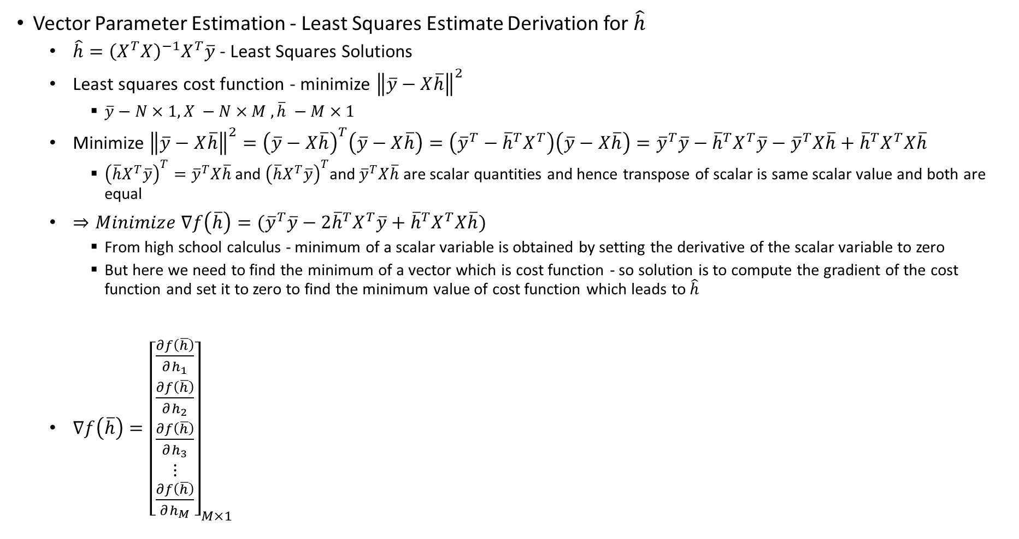
Quiz-2 – 28th Oct 2023
Vector Parameter Estimation - Least Squares Estimate Derivation for $\hat{h}$
  $\hat{h}={\left(X^{T}X\right)}^{−1}X^{T}\overline{y}$ - Least Squares Solutions
  Least squares cost function - minimize ${\left\|\overline{y}−X\overline{h}\right\|}^{2}$
    $\overline{y}−N×1, X −N×M , \overline{h} −M×1$
  Minimize ${\left\|\overline{y}−X\overline{h}\right\|}^{2}={\left(\overline{y}−X\overline{h}\right)}^{T}\left(\overline{y}−X\overline{h}\right)=\left({\overline{y}}^{T}−{\overline{h}}^{T}X^{T}\right)\left(\overline{y}−X\overline{h}\right)={\overline{y}}^{T}\overline{y}−{\overline{h}}^{T}X^{T}\overline{y}−{\overline{y}}^{T}X\overline{h}+{\overline{h}}^{T}X^{T}X\overline{h}$
    ${\left(\overline{h}X^{T}\overline{y}\right)}^{T}={\overline{y}}^{T}X\overline{h}$ and ${\left(\overline{h}X^{T}\overline{y}\right)}^{T}$and ${\overline{y}}^{T}X\overline{h}$ are scalar quantities and hence transpose of scalar is same scalar value and both are equal
  $⇒Minimize ∇f\left(\overline{h}\right)=({\overline{y}}^{T}\overline{y}−{2\overline{h}}^{T}X^{T}\overline{y}+{\overline{h}}^{T}X^{T}X\overline{h})$
    From high school calculus - minimum of a scalar variable is obtained by setting the derivative of the scalar variable to zero
    But here we need to find the minimum of a vector which is cost function - so solution is to compute the gradient of the cost function and set it to zero to find the minimum value of cost function which leads to $\hat{h}$
  $∇f\left(\overline{h}\right)={\left[\begin{matrix}\frac{∂f\left(\overline{h}\right)}{∂h_{1}} \\ \frac{∂f\left(\overline{h}\right)}{∂h_{2}} \\ \begin{aligned}\frac{∂f\left(\overline{h}\right)}{∂h_{3}} \\ ⋮ \\ \frac{∂f\left(\overline{h}\right)}{∂h_{M}}\end{aligned}\end{matrix}\right]}_{M×1}$

Slide 17
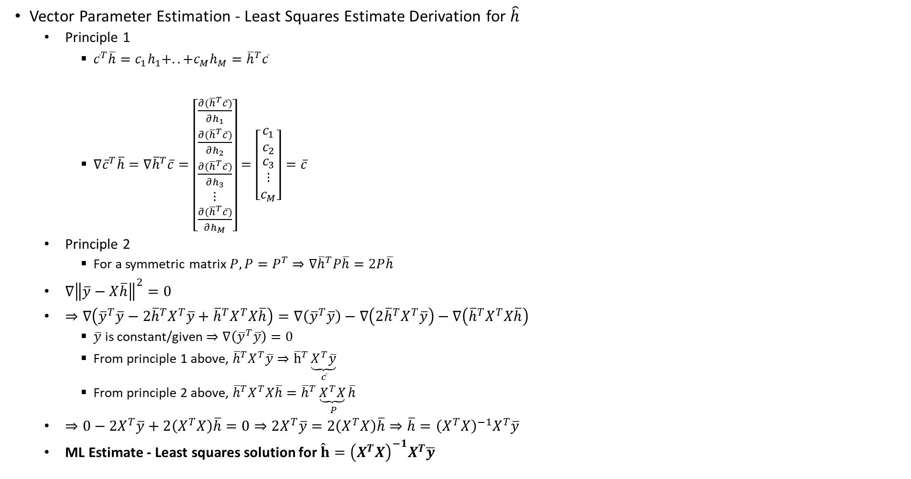
Quiz-2 – 28th Oct 2023
Vector Parameter Estimation - Least Squares Estimate Derivation for $\hat{h}$
  Principle 1
    ${\overline{c}}^{T}\overline{h}=c_{1}h_{1}+..+c_{M}h_{M}={\overline{h}}^{T}\overline{c}$
    $∇{\overline{c}}^{T}\overline{h}=∇{\overline{h}}^{T}\overline{c}=\left[\begin{matrix}\frac{∂({\overline{h}}^{T}\overline{c})}{∂h_{1}} \\ \frac{∂({\overline{h}}^{T}\overline{c})}{∂h_{2}} \\ \begin{aligned}\frac{∂({\overline{h}}^{T}\overline{c})}{∂h_{3}} \\ ⋮ \\ \frac{∂({\overline{h}}^{T}\overline{c})}{∂h_{M}}\end{aligned}\end{matrix}\right]=\left[\begin{matrix}c_{1} \\ c_{2} \\ \begin{aligned}c_{3} \\ ⋮ \\ c_{M}\end{aligned}\end{matrix}\right]=\overline{c}$
  Principle 2
    For a symmetric matrix $P, P=P^{T}⇒∇{\overline{h}}^{T}P\overline{h}=2P\overline{h}$
  $∇{\left\|\overline{y}−X\overline{h}\right\|}^{2}=0$
  $⇒∇\left({\overline{y}}^{T}\overline{y}−{2\overline{h}}^{T}X^{T}\overline{y}+{\overline{h}}^{T}X^{T}X\overline{h}\right)=∇\left({\overline{y}}^{T}\overline{y}\right)−∇\left({2\overline{h}}^{T}X^{T}\overline{y}\right)−∇\left({\overline{h}}^{T}X^{T}X\overline{h}\right)$
    $\overline{y}$ is constant/given $⇒∇\left({\overline{y}}^{T}\overline{y}\right)=0$
    From principle 1 above, ${\overline{h}}^{T}X^{T}\overline{y}⇒{\overline{h}}^{T}\underset{\overline{c}}{\underbrace{X^{T}\overline{y}}}$
    From principle 2 above, ${\overline{h}}^{T}X^{T}X\overline{h}={\overline{h}}^{T}\underset{ P}{\underbrace{X^{T}X}}\overline{h}$
  $⇒0−2X^{T}\overline{y}+2\left(X^{T}X\right)\overline{h}=0⇒2X^{T}\overline{y}=2\left(X^{T}X\right)\overline{h}⇒\overline{h}={\left(X^{T}X\right)}^{−1}X^{T}\overline{y}$
  ML Estimate - Least squares solution for $\hat{h}={\left(X^{T}X\right)}^{−1}X^{T}\overline{y}$

Slide 18
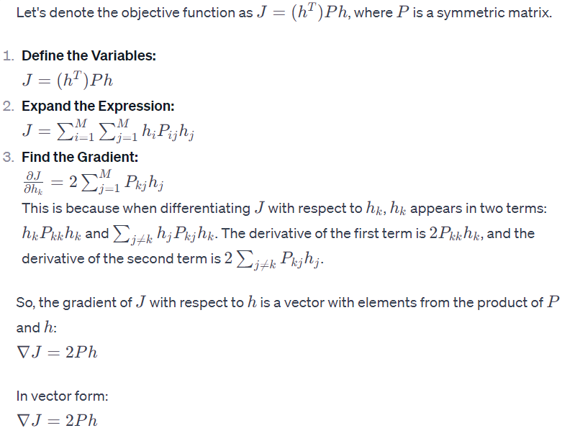
Computation of $∇{\overline{h}}^{T}P\overline{h}$

Slide 19
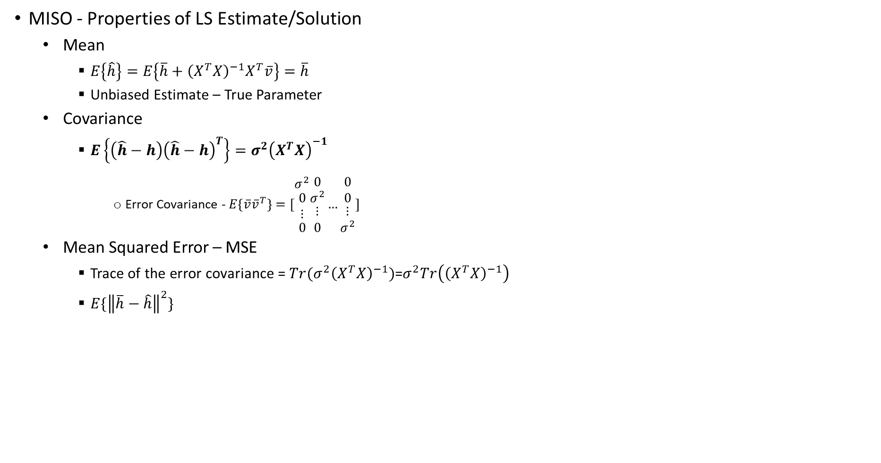
Quiz-2 – 28th Oct 2023
MISO - Properties of LS Estimate/Solution
  Mean
    $E\left\{\hat{h}\right\}=E\left\{\overline{h}+{\left(X^{T}X\right)}^{−1}X^{T}\overline{v}\right\}=\overline{h}$
    Unbiased Estimate – True Parameter
  Covariance
    $E\left\{\left(\hat{h}−h\right){\left(\hat{h}−h\right)}^{T}\right\}=σ^{2}{\left(X^{T}X\right)}^{−1}$
      Error Covariance - $E\left\{\overline{v}{\overline{v}}^{T}\right\}=[\begin{matrix}σ^{2} \\ \begin{aligned}0 \\ ⋮\end{aligned} \\ 0\end{matrix}\begin{matrix}0 \\ σ^{2} \\ \begin{aligned}⋮ \\ 0\end{aligned}\end{matrix}…\begin{matrix}0 \\ 0 \\ \begin{aligned}⋮ \\ σ^{2}\end{aligned}\end{matrix}]$
  Mean Squared Error – MSE
    Trace of the error covariance = $Tr(σ^{2}{\left(X^{T}X\right)}^{−1})$=$σ^{2}Tr\left({\left(X^{T}X\right)}^{−1}\right)$
    $E\{{\left\|\overline{h}−\hat{h}\right\|}^{2}\}$

Slide 20
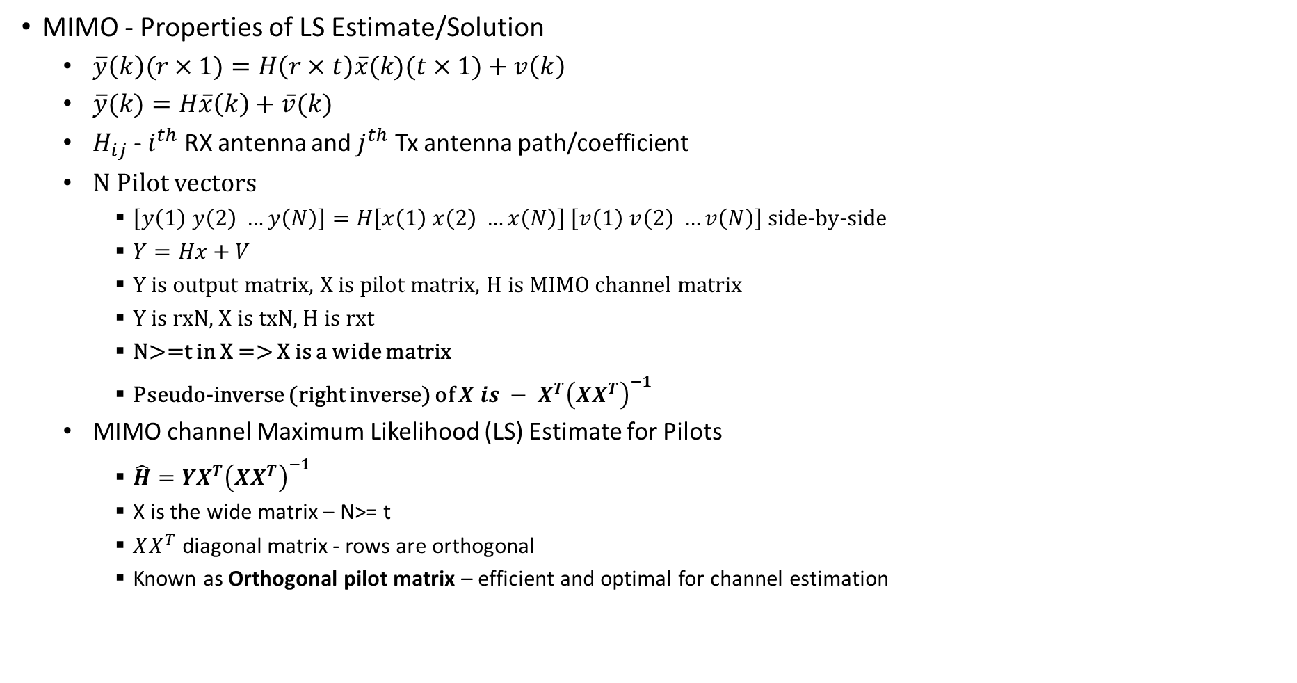
Quiz-2 – 28th Oct 2023
MIMO - Properties of LS Estimate/Solution
  $\overline{y}\left(k\right)(r×1)=H\left(r×t\right)\overline{x}(k)(t×1)+v\left(k\right)$
  $\overline{y}(k)=H\overline{x}\left(k\right)+\overline{v}(k)$
  $H_{ij}$ - $i^{th}$ RX antenna and $j^{th}$ Tx antenna path/coefficient
  N Pilot vectors
    $\left[y\left(1\right) y\left(2\right) …y\left(N\right)\right]=H\left[x\left(1\right) x\left(2\right) …x\left(N\right)\right] \left[v\left(1\right) v\left(2\right) …v\left(N\right)\right]$ side-by-side
    $Y=Hx+V$
    Y is output matrix, X is pilot matrix, H is MIMO channel matrix
    Y is rxN, X is txN, H is rxt
    N>=t in X => X is a wide matrix
    Pseudo-inverse (right inverse) of ${X is − X}^{T}{\left(XX^{T}\right)}^{−1}$
  MIMO channel Maximum Likelihood (LS) Estimate for Pilots
    $\hat{H}=YX^{T}{\left(XX^{T}\right)}^{−1}$
    X is the wide matrix – N>= t
    $XX^{T}$ diagonal matrix - rows are orthogonal
    Known as Orthogonal pilot matrix – efficient and optimal for channel estimation

Slide 21
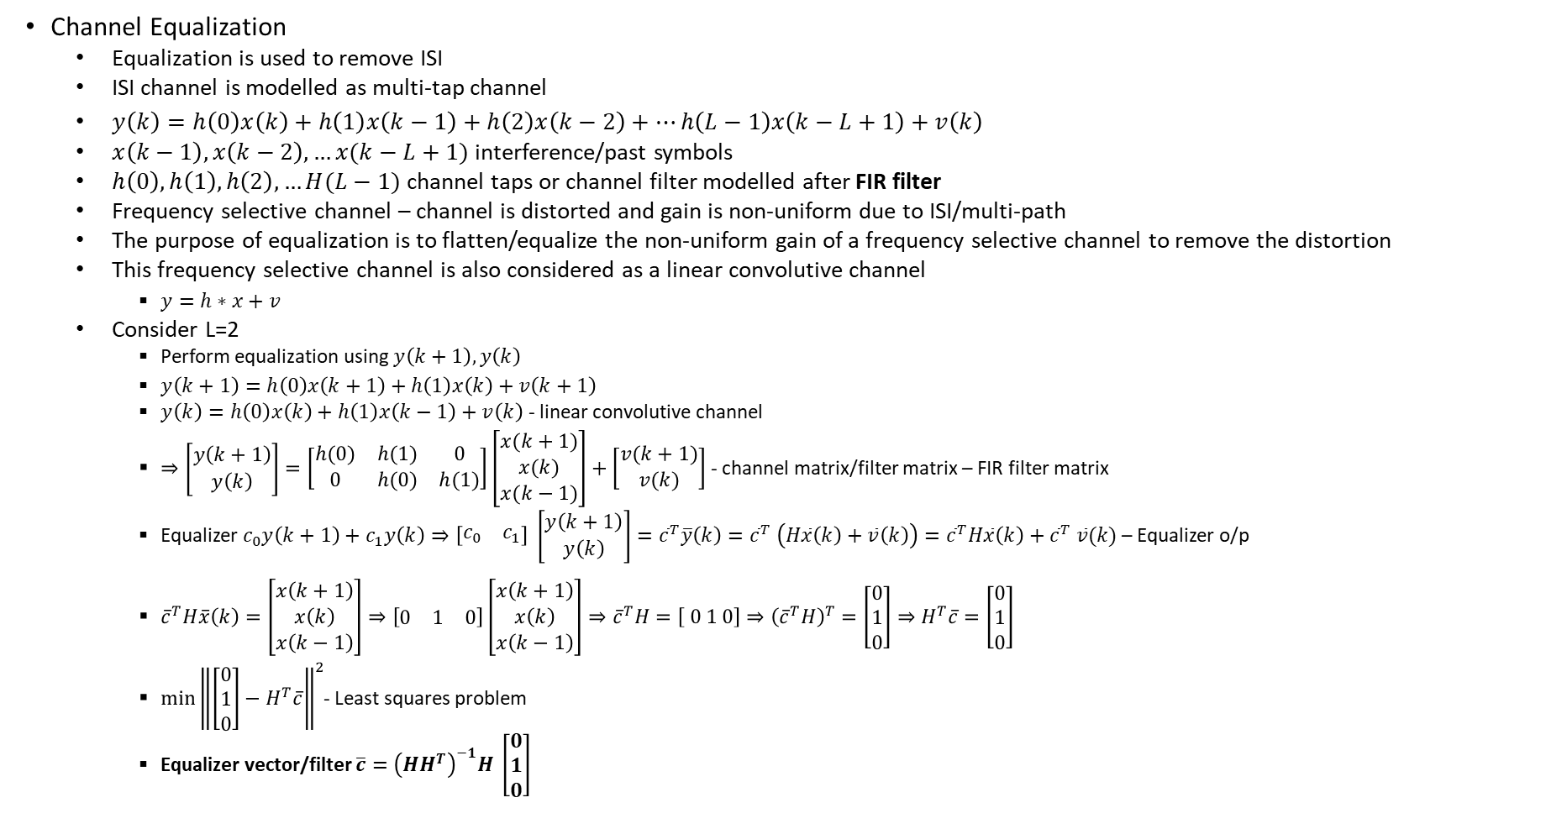
Quiz-2 – 28th Oct 2023
Channel Equalization
  Equalization is used to remove ISI
  ISI channel is modelled as multi-tap channel
  $y\left(k\right)=h\left(0\right)x\left(k\right)+h\left(1\right)x\left(k−1\right)+h\left(2\right)x\left(k−2\right)+…h\left(L−1\right)x\left(k−L+1\right)+v\left(k\right)$
  $x\left(k−1\right), x\left(k−2\right),…x(k−L+1)$ interference/past symbols
  $h\left(0\right), h\left(1\right), h\left(2\right),…H(L−1)$ channel taps or channel filter modelled after FIR filter
  Frequency selective channel – channel is distorted and gain is non-uniform due to ISI/multi-path
  The purpose of equalization is to flatten/equalize the non-uniform gain of a frequency selective channel to remove the distortion
  This frequency selective channel is also considered as a linear convolutive channel
    $y=h∗x+v$
  Consider L=2
    Perform equalization using $y\left(k+1\right), y\left(k\right)$
    $y\left(k+1\right)=h\left(0\right)x\left(k+1\right)+h\left(1\right)x\left(k\right)+v\left(k+1\right)$
    $y\left(k\right)=h\left(0\right)x\left(k\right)+h\left(1\right)x\left(k−1\right)+v\left(k\right)$ - linear convolutive channel
    $⇒\left[\begin{matrix}y\left(k+1\right) \\ y\left(k\right)\end{matrix}\right]=\left[\begin{matrix}h(0) & h(1) & 0 \\ 0 & h(0) & h(1)\end{matrix}\right]\left[\begin{matrix}x(k+1) \\ x(k) \\ x(k−1)\end{matrix}\right]+\left[\begin{matrix}v(k+1) \\ v(k)\end{matrix}\right]$ - channel matrix/filter matrix – FIR filter matrix
    Equalizer $c_{0}y\left(k+1\right)+c_{1}y\left(k\right)⇒\left[\begin{matrix}c_{0} & c_{1}\end{matrix}\right] \left[\begin{matrix}y\left(k+1\right) \\ y\left(k\right)\end{matrix}\right]={\overline{c}}^{T}\overline{y}\left(k\right)={\overline{c}}^{T} \left(H\overline{x}\left(k\right)+\overline{v}\left(k\right)\right)={\overline{c}}^{T}H\overline{x}\left(k\right)+{\overline{c}}^{T} \overline{v}(k)$ – Equalizer o/p
    ${\overline{c}}^{T}H\overline{x}\left(k\right)=\left[\begin{matrix}x\left(k+1\right) \\ x\left(k\right) \\ x\left(k−1\right)\end{matrix}\right]⇒\left[\begin{matrix}0 & 1 & 0\end{matrix}\right]\left[\begin{matrix}x\left(k+1\right) \\ x\left(k\right) \\ x\left(k−1\right)\end{matrix}\right]⇒{\overline{c}}^{T}H=\left[ 0 1 0\right]⇒{\left({\overline{c}}^{T}H\right)}^{T}=\left[\begin{matrix}0 \\ 1 \\ 0\end{matrix}\right]⇒H^{T}\overline{c}=\left[\begin{matrix}0 \\ 1 \\ 0\end{matrix}\right]$
    $\min_{ }{{\left\|\left[\begin{matrix}0 \\ 1 \\ 0\end{matrix}\right]−H^{T}\overline{c}\right\|}^{2}}$- Least squares problem
    Equalizer vector/filter $\overline{c}={\left(HH^{T}\right)}^{−1}H \left[\begin{matrix}0 \\ 1 \\ 0\end{matrix}\right]$

Slide 22
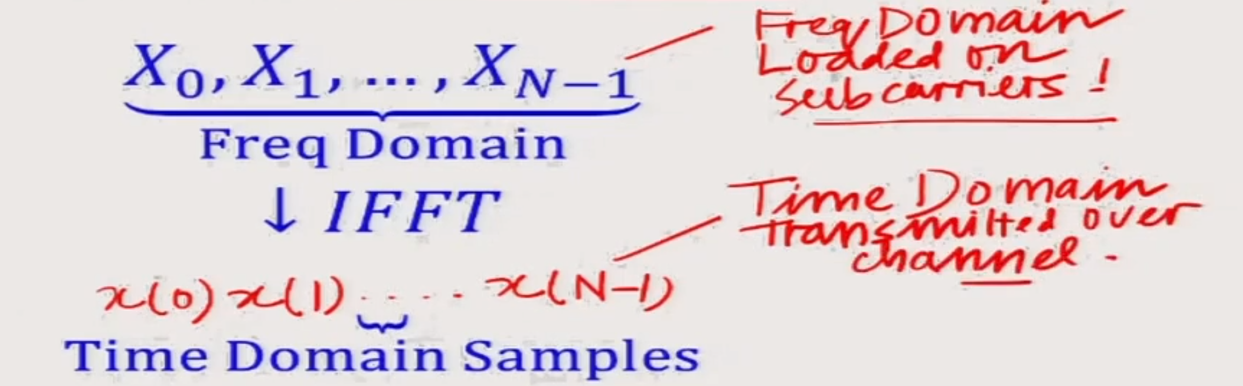
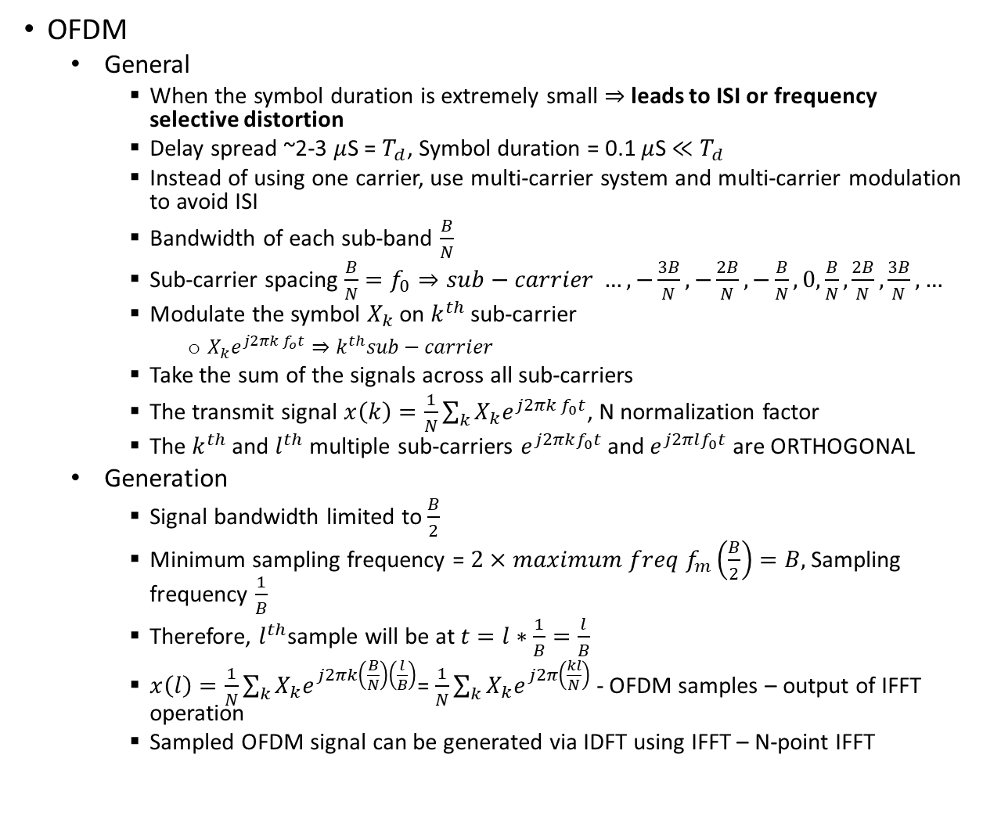
Quiz 3
OFDM
  General
    When the symbol duration is extremely small $⇒$ leads to ISI or frequency selective distortion
    Delay spread ~2-3 $μ$S = $T_{d}$, Symbol duration = 0.1 $μ$S $≪T_{d}$
    Instead of using one carrier, use multi-carrier system and multi-carrier modulation to avoid ISI
    Bandwidth of each sub-band $\frac{B}{N}$
    Sub-carrier spacing $\frac{B}{N}=f_{0}⇒sub−carrier …,−\frac{3B}{N}, −\frac{2B}{N}, −\frac{B}{N}, 0,\frac{B}{N},\frac{2B}{N},\frac{3B}{N},…$
    Modulate the symbol $X_{k}$ on $k^{th}$ sub-carrier
      $X_{k}e^{j2πk f_{o}t}⇒k^{th}sub−carrier$
    Take the sum of the signals across all sub-carriers
    The transmit signal $x\left(k\right)=\frac{1}{N}\sum_{k}^{ }{X_{k}e^{j2πk f_{0}t}}$, N normalization factor
    The $k^{th}$ and $l^{th}$ multiple sub-carriers $e^{j2πkf_{0}t}$ and $e^{j2πlf_{0}t}$ are ORTHOGONAL
  Generation
    Signal bandwidth limited to $\frac{B}{2}$
    Minimum sampling frequency = $2×maximum freq f_{m}\left(\frac{B}{2}\right)=B,$Sampling frequency $\frac{1}{B}$
    Therefore, $l^{th}$sample will be at $t=l∗\frac{1}{B}=\frac{l}{B}$
    $x\left(l\right)=\frac{1}{N}\sum_{k}^{ }{X_{k}e^{j2πk\left(\frac{B}{N}\right)\left(\frac{l}{B}\right)}}$= $\frac{1}{N}\sum_{k}^{ }{X_{k}e^{j2π\left(\frac{kl}{N}\right)}}$ - OFDM samples – output of IFFT operation
    Sampled OFDM signal can be generated via IDFT using IFFT – N-point IFFT

Slide 23
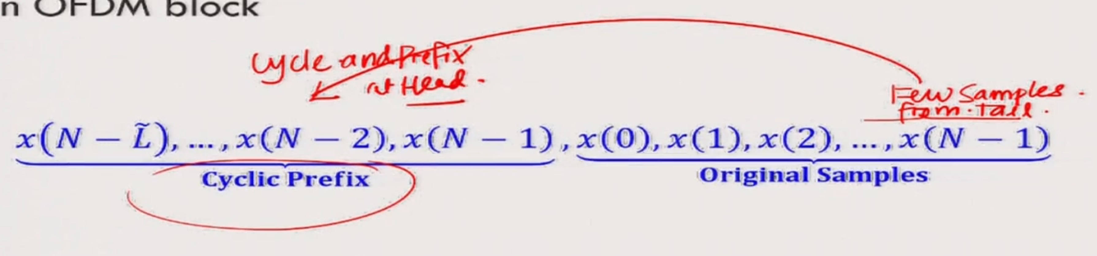
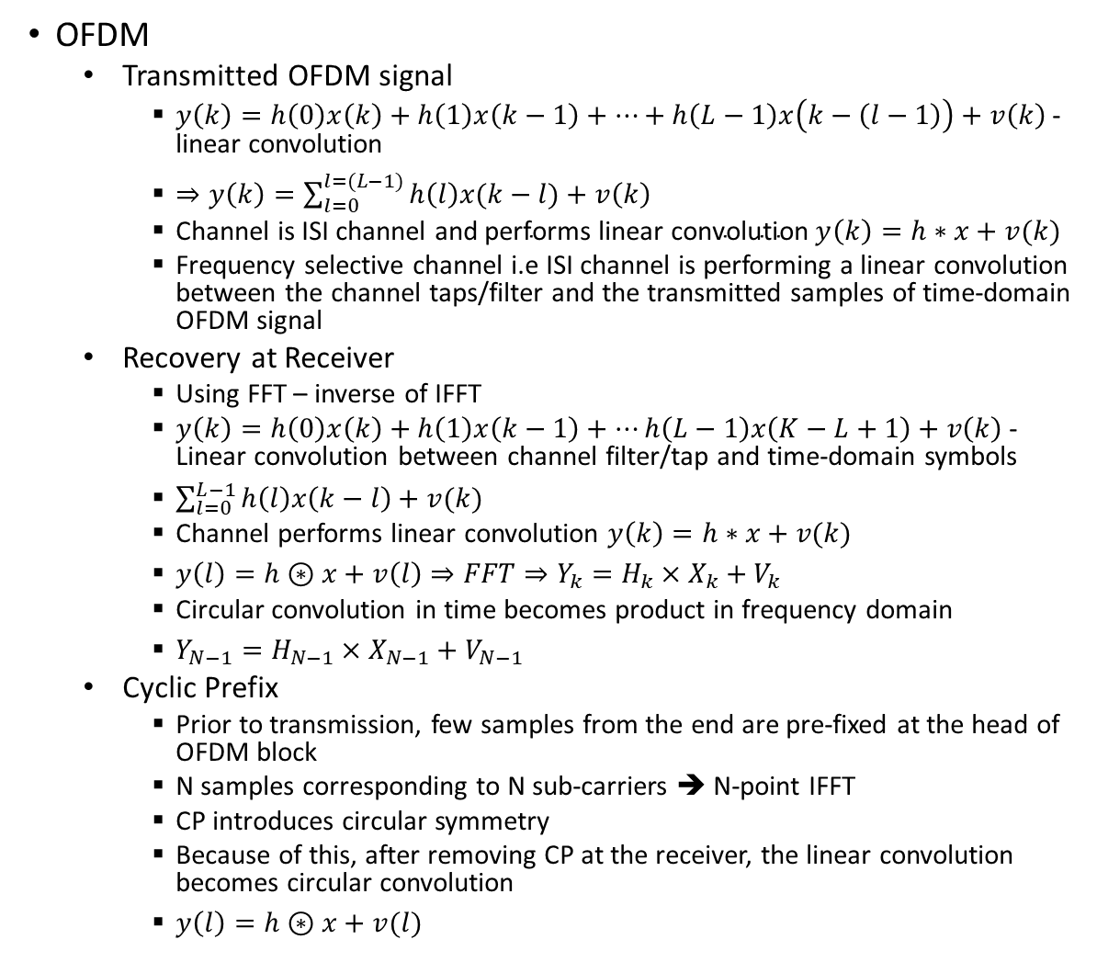
Quiz 3
OFDM
  Transmitted OFDM signal
    $y\left(k\right)=h\left(0\right)x\left(k\right)+h\left(1\right)x\left(k−1\right)+…+h\left(L−1\right)x\left(k−\left(l−1\right)\right)+v\left(k\right)$ - linear convolution
    $⇒y\left(k\right)=\sum_{l=0}^{l=(L−1)}{h\left(l\right)x(k−l)}+v\left(k\right)$
    Channel is ISI channel and $\text{performs} \text{linear} \text{convolution} y\left(k\right)=h∗x+v(k)$
    Frequency selective channel i.e ISI channel is performing a linear convolution between the channel taps/filter and the transmitted samples of time-domain OFDM signal
  Recovery at Receiver
    Using FFT – inverse of IFFT
    $y\left(k\right)=h\left(0\right)x\left(k\right)+h\left(1\right)x\left(k−1\right)+…h\left(L−1\right)x\left(K−L+1\right)+v\left(k\right)$ - Linear convolution between channel filter/tap and time-domain symbols
    $\sum_{l=0}^{L−1}{h\left(l\right)x\left(k−l\right)+v(k})$
    Channel performs linear convolution $y\left(k\right)=h∗x+v(k)$
    $y\left(l\right)=h⊛x+v\left(l\right)⇒FFT⇒Y_{k}=H_{k}×X_{k}+V_{k}$
    Circular convolution in time becomes product in frequency domain
    $Y_{N−1}=H_{N−1}×X_{N−1}+V_{N−1}$
  Cyclic Prefix
    Prior to transmission, few samples from the end are pre-fixed at the head of OFDM block
    N samples corresponding to N sub-carriers ➔ N-point IFFT
    CP introduces circular symmetry
    Because of this, after removing CP at the receiver, the linear convolution becomes circular convolution
    $y\left(l\right)=h⊛x+v(l)$

Slide 24
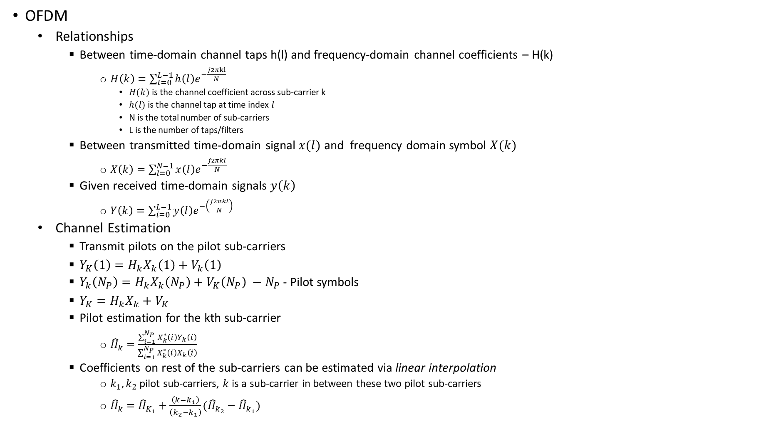
Quiz 3
OFDM
  Relationships
    Between time-domain channel taps h(l) and frequency-domain channel coefficients – H(k)
      $H\left(k\right)=\sum_{l=0}^{L−1}{h\left(l\right)e^{−\frac{j2πkl}{N}}}$
        $H(k)$ is the channel coefficient across sub-carrier k
        $h(l)$ is the channel tap at time index $l$
        N is the total number of sub-carriers
        L is the number of taps/filters
    Between transmitted time-domain signal $x(l)$ and frequency domain symbol $X(k)$
      $X\left(k\right)=\sum_{l=0}^{N−1}{x\left(l\right)e^{−\frac{j2πkl}{N}}}$
    Given received time-domain signals $y\left(k\right)$
      $Y\left(k\right)=\sum_{i=0}^{L−1}{y\left(l\right)e^{−\left(\frac{j2πkl}{N}\right)} }$
  Channel Estimation
    Transmit pilots on the pilot sub-carriers
    $Y_{K}\left(1\right)=H_{k}X_{k}\left(1\right)+V_{k}\left(1\right)$
    $Y_{k}\left(N_{P}\right)=H_{k}X_{k}\left(N_{P}\right)+V_{K}\left(N_{P}\right) −N_{P}$ - Pilot symbols
    $Y_{K}=H_{k}X_{k}+V_{K}$
    Pilot estimation for the kth sub-carrier
      ${\hat{H}}_{k}=$ $\frac{\sum_{i=1}^{N_{P}}{X_{k}^{∗}\left(i\right)Y_{k}\left(i\right)}}{\sum_{i=1}^{N_{P}}{X_{k}^{∗}\left(i\right)X_{k}\left(i\right)}}$
    Coefficients on rest of the sub-carriers can be estimated via linear interpolation
      $k_{1}, k_{2}$ pilot sub-carriers, $k$ is a sub-carrier in between these two pilot sub-carriers
      ${\hat{H}}_{k}={\hat{H}}_{K_{1}}+\frac{\left(k−k_{1}\right)}{\left(k_{2}−k_{1}\right)}({\hat{H}}_{k_{2}}−{\hat{H}}_{k_{1}})$

Slide 25
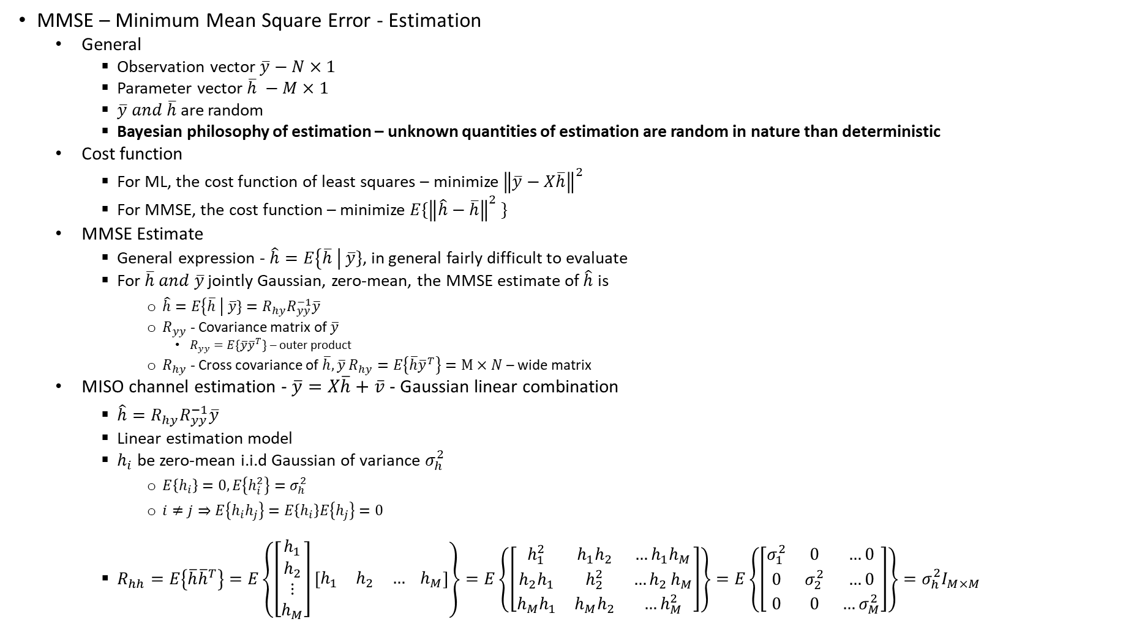
Quiz 3
MMSE – Minimum Mean Square Error - Estimation
  General
    Observation vector $\overline{y}−N×1$
    Parameter vector $\overline{h} −M×1$
    $\overline{y} and \overline{h}$ are random
    Bayesian philosophy of estimation – unknown quantities of estimation are random in nature than deterministic
  Cost function
    For ML, the cost function of least squares – minimize ${\left\|\overline{y}−X\overline{h}\right\|}^{2}$
    For MMSE, the cost function – minimize $E\{{\left\|\hat{h}−\overline{h}\right\|}^{2} \}$
  MMSE Estimate
    General expression - $\hat{h}=E\left\{\overline{h} \right| \overline{y}\}$, in general fairly difficult to evaluate
    For $\overline{h} and \overline{y}$ jointly Gaussian, zero-mean, the MMSE estimate of $\hat{h}$ is
      $\hat{h}=E\left\{\overline{h} \right| \overline{y}\}=R_{hy}R_{yy}^{−1}\overline{y}$
      $R_{yy}$ - Covariance matrix of $\overline{y}$
        $R_{yy}=E\{\overline{y}{\overline{y}}^{T}\}$ – outer product
      $R_{hy}$ - Cross covariance of $\overline{h}, \overline{y}$ $R_{hy}=E\left\{\overline{h}{\overline{y}}^{T}\right\}=M×N$ – wide matrix
  MISO channel estimation - $\overline{y}=X\overline{h}+\overline{v}$ - Gaussian linear combination
    $\hat{h}=R_{hy}R_{yy}^{−1}\overline{y}$
    Linear estimation model
    $h_{i}$ be zero-mean i.i.d Gaussian of variance $σ_{h}^{2}$
      $E\left\{h_{i}\right\}=0, E\left\{h_{i}^{2}\right\}=σ_{h}^{2}$
      $i≠j⇒E\left\{h_{i}h_{j}\right\}=E\left\{h_{i}\right\}E\left\{h_{j}\right\}=0$
    $R_{hh}=E\left\{\overline{h}{\overline{h}}^{T}\right\}=E\left\{\left[\begin{matrix}h_{1} \\ h_{2} \\ \begin{aligned}⋮ \\ h_{M}\end{aligned}\end{matrix}\right]\left[\begin{matrix}h_{1} & h_{2} & … h_{M}\end{matrix}\right]\right\}=E\left\{\left[\begin{matrix}h_{1}^{2} & h_{1}h_{2} & …h_{1}h_{M} \\ h_{2}h_{1} & h_{2}^{2} & {…h}_{2}h_{M} \\ h_{M}h_{1} & h_{M}h_{2} & …h_{M}^{2}\end{matrix}\right]\right\}=E\left\{\left[\begin{matrix}σ_{1}^{2} & 0 & …0 \\ 0 & σ_{2}^{2} & …0 \\ 0 & 0 & …σ_{M}^{2}\end{matrix}\right]\right\}=σ_{h}^{2}I_{M×M }$

Slide 26
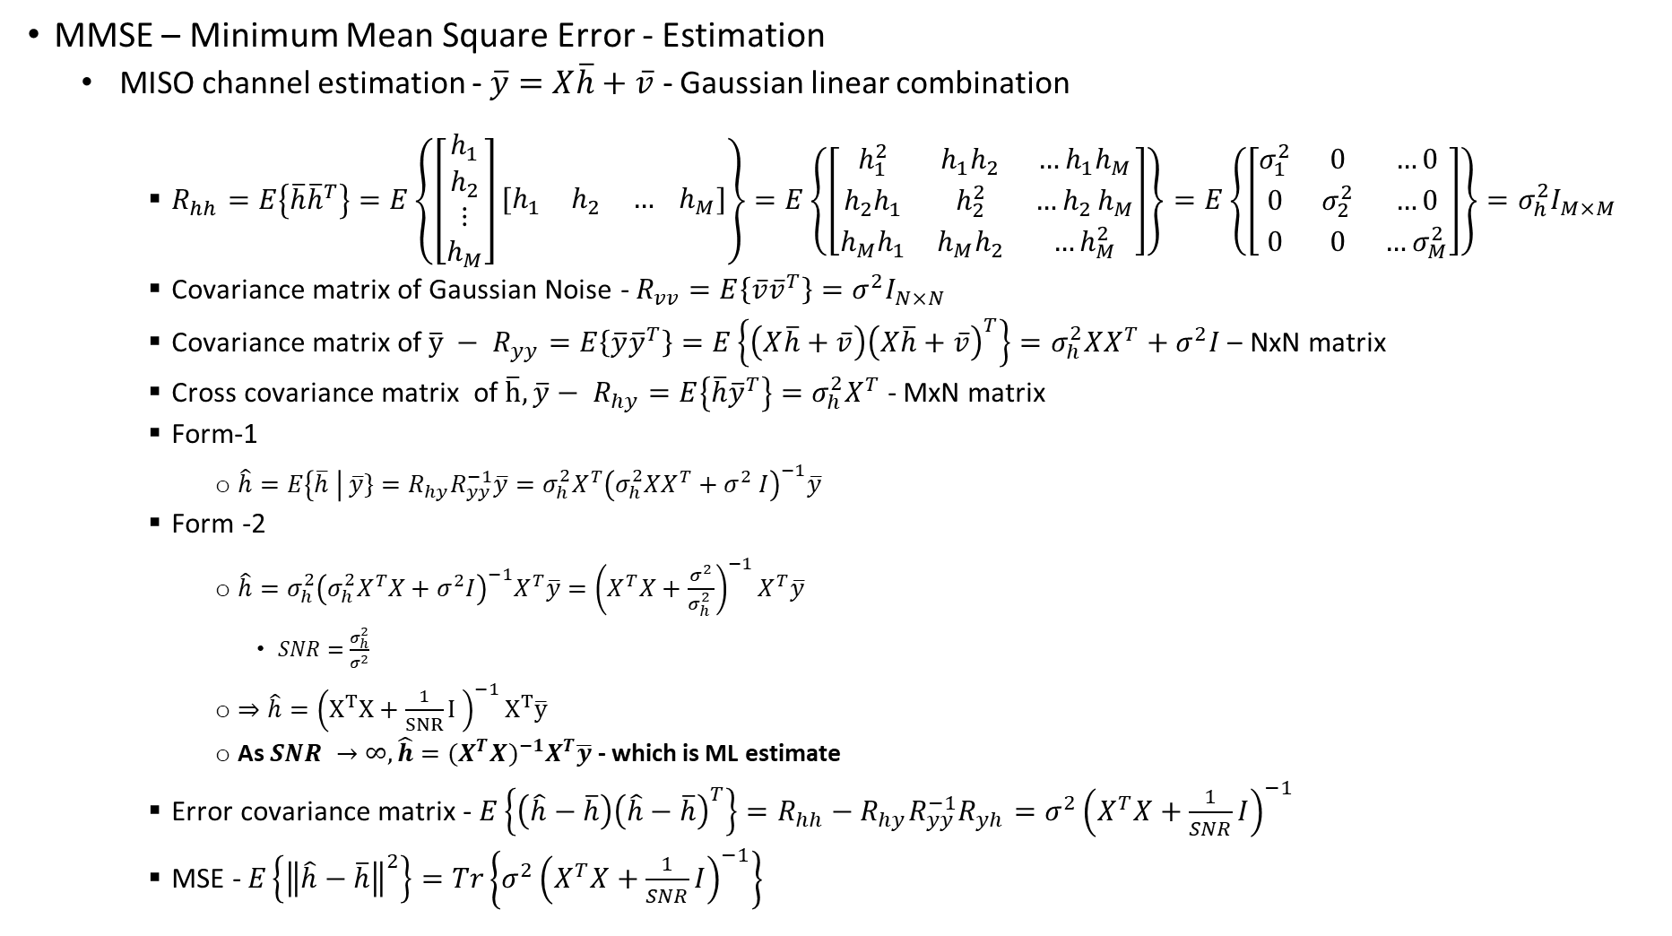
Quiz 3
MMSE – Minimum Mean Square Error - Estimation
  MISO channel estimation - $\overline{y}=X\overline{h}+\overline{v}$ - Gaussian linear combination
    $R_{hh}=E\left\{\overline{h}{\overline{h}}^{T}\right\}=E\left\{\left[\begin{matrix}h_{1} \\ h_{2} \\ \begin{aligned}⋮ \\ h_{M}\end{aligned}\end{matrix}\right]\left[\begin{matrix}h_{1} & h_{2} & … h_{M}\end{matrix}\right]\right\}=E\left\{\left[\begin{matrix}h_{1}^{2} & h_{1}h_{2} & …h_{1}h_{M} \\ h_{2}h_{1} & h_{2}^{2} & {…h}_{2}h_{M} \\ h_{M}h_{1} & h_{M}h_{2} & …h_{M}^{2}\end{matrix}\right]\right\}=E\left\{\left[\begin{matrix}σ_{1}^{2} & 0 & …0 \\ 0 & σ_{2}^{2} & …0 \\ 0 & 0 & …σ_{M}^{2}\end{matrix}\right]\right\}=σ_{h}^{2}I_{M×M }$
    Covariance matrix of Gaussian Noise - $R_{vv}=E\left\{\overline{v}{\overline{v}}^{T}\right\}=σ^{2}I_{N×N}$
    Covariance matrix of $\overline{y} − R_{yy}=E\left\{\overline{y}{\overline{y}}^{T}\right\}=E\left\{\left(X\overline{h}+\overline{v}\right){\left(X\overline{h}+\overline{v}\right)}^{T}\right\}=σ_{h}^{2}XX^{T}+σ^{2}I$– NxN matrix
    Cross covariance matrix of $\overline{h}, \overline{y}− R_{hy}=E\left\{\overline{h}{\overline{y}}^{T}\right\}=σ_{h}^{2}X^{T}$ - MxN matrix
    Form-1
      $\hat{h}=E\left\{\overline{h} \right| \overline{y}\}=R_{hy}R_{yy}^{−1}\overline{y}=σ_{h}^{2}X^{T}{\left(σ_{h}^{2}XX^{T}+σ^{2} I\right)}^{−1}\overline{y}$
    Form -2
      $\hat{h}=σ_{h}^{2}{\left(σ_{h}^{2}X^{T}X+σ^{2}I\right)}^{−1}X^{T}\overline{y}={\left(X^{T}X+\frac{σ^{2}}{σ_{h}^{2} }\right)}^{−1}X^{T}\overline{y}$
        $SNR=\frac{σ_{h}^{2}}{σ^{2}}$
      $⇒\hat{h}={\left(X^{T}X+\frac{1}{SNR}I \right)}^{−1}X^{T}\overline{y}$
      As $SNR →∞, \hat{h}={(X^{T}X)}^{−1}X^{T}\overline{y}$ - which is ML estimate
    Error covariance matrix - $E\left\{\left(\hat{h}−\overline{h}\right){\left(\hat{h}−\overline{h}\right)}^{T}\right\}=R_{hh}−R_{hy}R_{yy}^{−1}R_{yh}=σ^{2}{\left(X^{T}X+\frac{1}{SNR}I\right)}^{−1}$
    MSE - $E\left\{{\left\|\hat{h}−\overline{h}\right\|}^{2}\right\}=Tr\left\{σ^{2}{\left(X^{T}X+\frac{1}{SNR}I\right)}^{−1}\right\}$

Slide 27
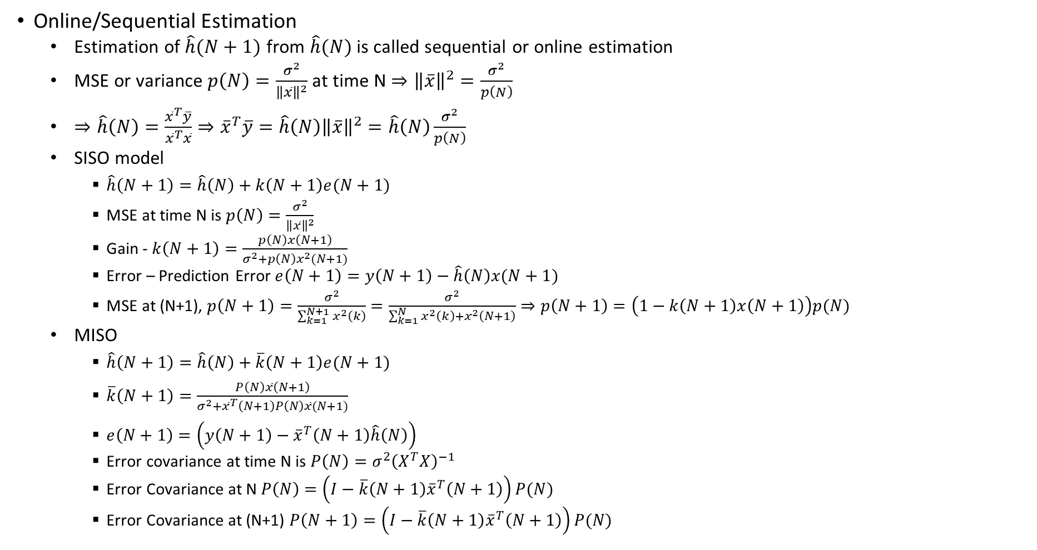
Quiz-4
Online/Sequential Estimation
  Estimation of $\hat{h}(N+1)$ from $\hat{h}(N)$ is called sequential or online estimation
  MSE or variance $p\left(N\right)=\frac{σ^{2}}{{\left\|\overline{x}\right\|}^{2}}$ at time N $⇒{\left\|\overline{x}\right\|}^{2}=\frac{σ^{2}}{p\left(N\right)}$
  $⇒\hat{h}\left(N\right)=\frac{{\overline{x}}^{T}\overline{y}}{{\overline{x}}^{T}\overline{x}}⇒{\overline{x}}^{T}\overline{y}=\hat{h}\left(N\right){\left\|\overline{x}\right\|}^{2}=\hat{h}\left(N\right)\frac{σ^{2}}{p\left(N\right)}$
  SISO model
    $\hat{h}\left(N+1\right)=\hat{h}\left(N\right)+k\left(N+1\right)e(N+1)$
    MSE at time N is $p\left(N\right)=\frac{σ^{2}}{{\left\|\overline{x}\right\|}^{2}}$
    Gain - $k\left(N+1\right)=\frac{p\left(N\right)x\left(N+1\right)}{σ^{2}+p\left(N\right)x^{2}(N+1)}$
    Error – Prediction Error $e\left(N+1\right)=y\left(N+1\right)−\hat{h}\left(N\right)x(N+1)$
    MSE at (N+1), $p\left(N+1\right)=\frac{σ^{2}}{\sum_{k=1}^{N+1}{x^{2}\left(k\right)}}=\frac{σ^{2}}{\sum_{k=1}^{N}{x^{2}\left(k\right)}+x^{2}\left(N+1\right)}⇒p\left(N+1\right)=\left(1−k\left(N+1\right)x\left(N+1\right)\right)p(N)$
  MISO
    $\hat{h}\left(N+1\right)=\hat{h}\left(N\right)+\overline{k}\left(N+1\right)e(N+1)$
    $\overline{k}\left(N+1\right)=\frac{P\left(N\right)\overline{x}\left(N+1\right)}{σ^{2}+{\overline{x}}^{T}\left(N+1\right)P\left(N\right)\overline{x}(N+1)}$
    $e\left(N+1\right)=\left(y\left(N+1\right)−{\overline{x}}^{T}\left(N+1\right)\hat{h}\left(N\right)\right)$
    Error covariance at time N is $P\left(N\right)=σ^{2}{\left(X^{T}X\right)}^{−1}$
    Error Covariance at N $P\left(N\right)=\left(I−\overline{k}\left(N+1\right){\overline{x}}^{T}\left(N+1\right)\right)P(N)$
    Error Covariance at (N+1) $P\left(N+1\right)=\left(I−\overline{k}\left(N+1\right){\overline{x}}^{T}\left(N+1\right)\right)P(N)$

Slide 28
Quiz-4 – Week-8

Slide 29
Thank you
Brillium Technologies
#501, C Block, Salarpuria Serenity, 5th Main, Sector 7, HSR Layout, Bengaluru 560102, Karnataka, India
Website: www.brillium.in | Email: connect@brillium.in

